Slide 1
Modern Education Society’s
Cusrow Wadia Institute of Technology , Pune 01.
Scholarship Section.
Information on Scholarship schemes by Mrs. Sayali Kane.

Slide 2
MahaDBT Scholarship Schemes.
Instruction for Filling MahaDBT Scholarship / Freeship / EBC Forms.
1) Scholarship website is https://mahadbtmahait.gov.in
Important Note: - Before applying on Mahadbt portal, Scan your all original the documents in pdf format or jpg format size from 150kb to 250kb for uploading on MahaDBT portal for Application. Do not upload blur images; it may reject your application.

Slide 3
List of documents required for uploading on mahadbt site
Upload following doucments in personal information menu
Check previously filled adhar base bank account details
Note :- All SC/OBC/VJNT/SBC students who took admision in institute level & for sc /st/obc/vjnt and sbc catergory income below 2.50 lakh and they can apply for scholarship. But firstly they have to pay full fee and then they can get refund from government directly to their adhar base bank account.

Slide 4
Follow following instruction carefully because your form may be rejected from Government
Upload following original documents in current year information
Delete previously pursuing details first then again fillup all information of previously filled with complited status for eg. Last year in 24-25 you are in first year the now your status is complited write both sem marks average & upload both dec 24 and may 25 marksheet
Note : Select your course proper especially mechanical and Electronics and Telecommunication students those who admitted in aided and unaided section because there is major difference in fees . Select Course Type Aided those admitted in aided section and Slect Course Type Unaided who admitted in unaided section
In CET Score you have write your 10th or 12 or ITI marks on which your admission is confirmed.
DTE Allotment letter Note :- Do not upload freeze confirm letter upload allotment letter which given by Institute.
Admission fee receipt. (Do not upload bonafide even if it mentioned) write fee paid zero
Note :-Those who paid full fee i.e. Rs.7550(aided) & Rs.80000/80041(unaided) they can write full amount.
Note:- Only St category students & SC category students whose income above 2.50 lakh must write fee paid Rs1550(aided) & Rs.10435/10075 (unaided)

Slide 5
Upload Following Documents in Hostel details menu:- Hostel fee receipt ( do not upload online copy proper fee receipt required) and Hostel Certificate of warden/ Rent agreement + light bill of owner + adhar card of student & owner

Slide 6
Upload all these original documents in all scheme menu
Undertaking
Leaving certificate (latest)
Ration card , non cremelayer( income above 2.5 lakh obc/sbc/vjnt/sebc students)
In caste validty column upload students caste certificate Note : Only ST student whose income is above Rs.250000 they must upload caste validity other than ST they can upload caste certificate

Slide 7
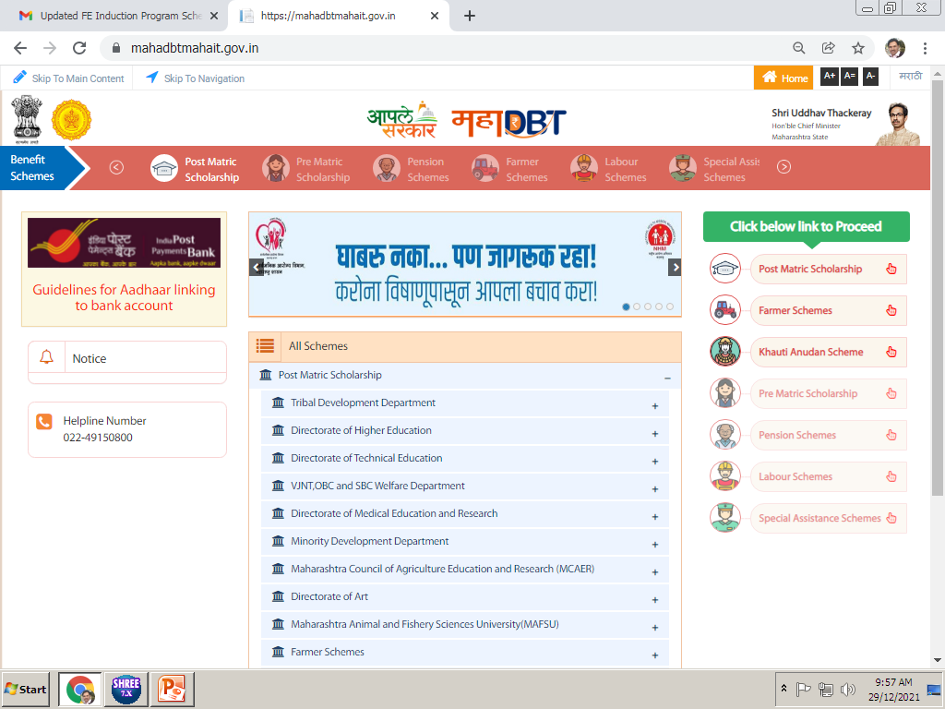
Click on the Post Matric Scholarship

Slide 8
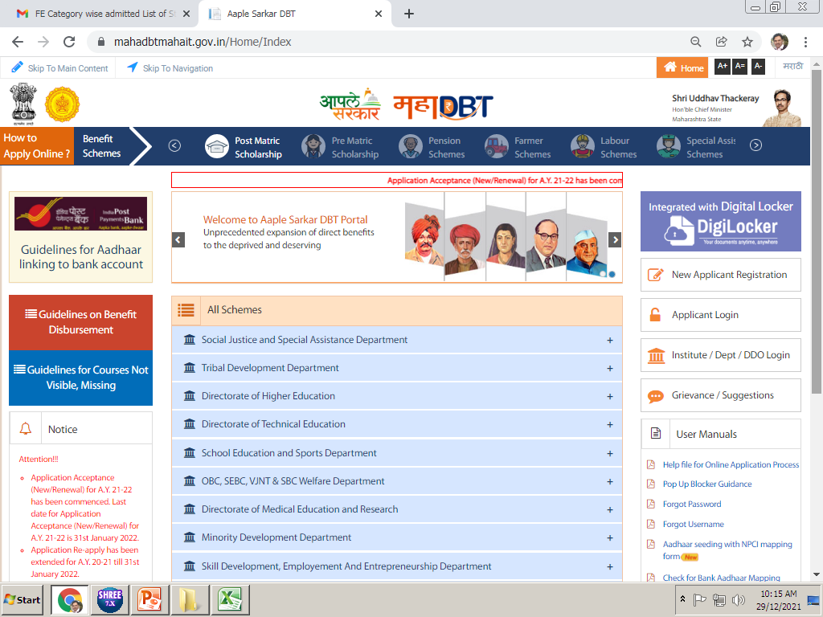
If you have filled this form in previous Academic year, you need to use applicant login option.

Slide 9
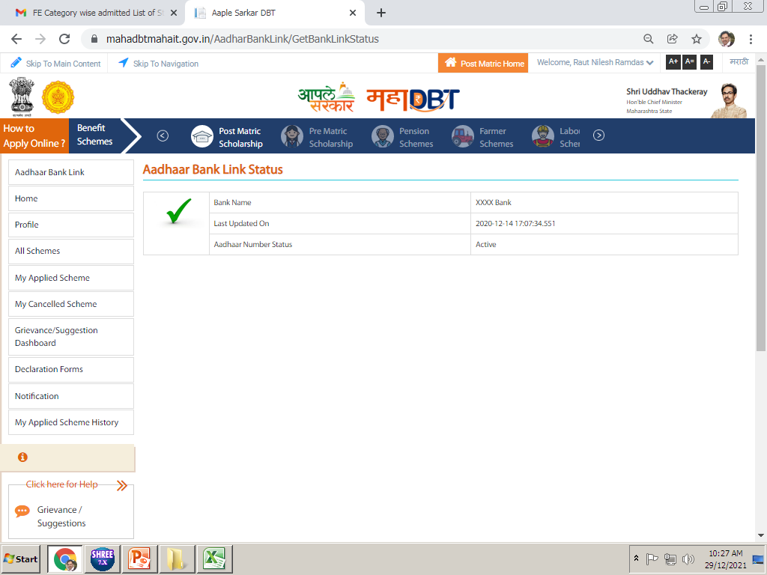
Click on the Profile option…

Slide 10
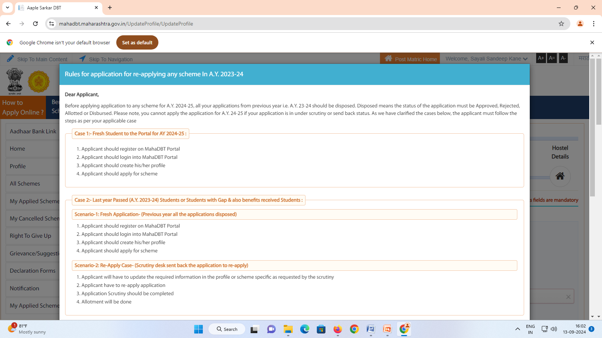
READ ALL INSTRUCTIONS CAREFULLY

Slide 11
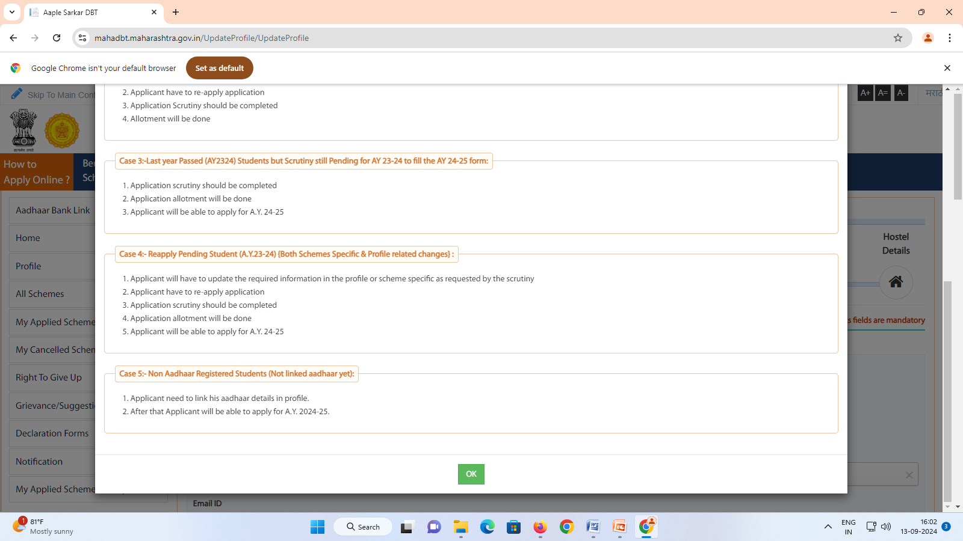
CLICK ON OK

Slide 12
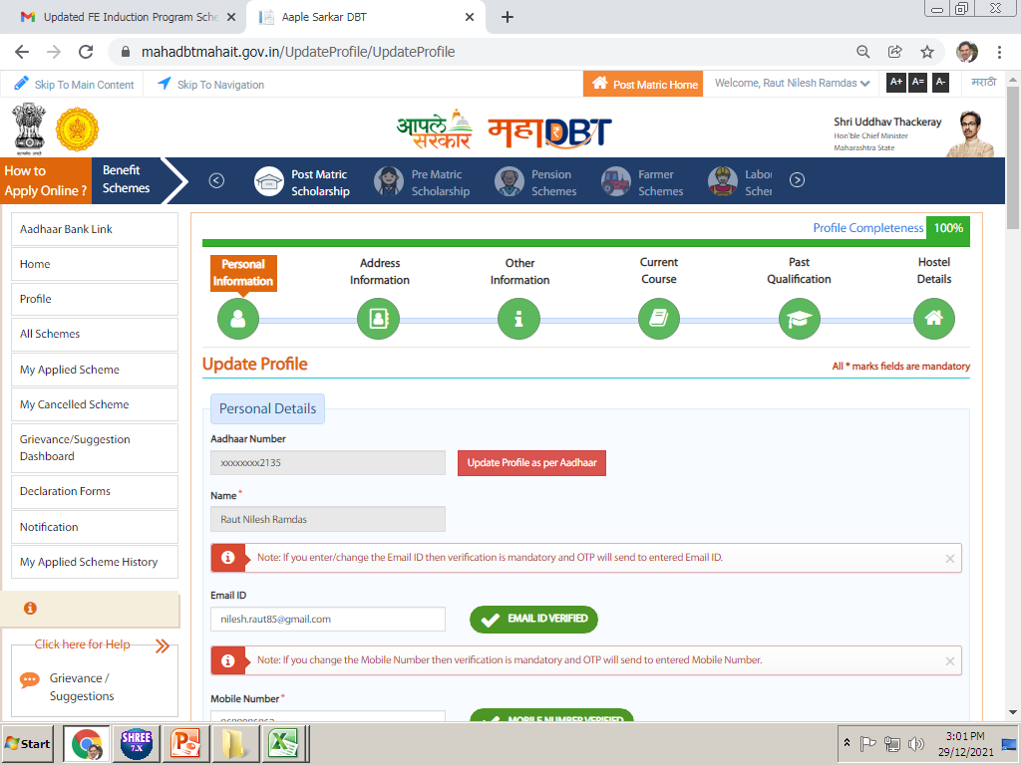
Click on update profile as per adhar
Notes:
Here we have to create our students profile in this option. Profile is distributed in six parts. We have to update all these six parts of Profile.

Slide 13
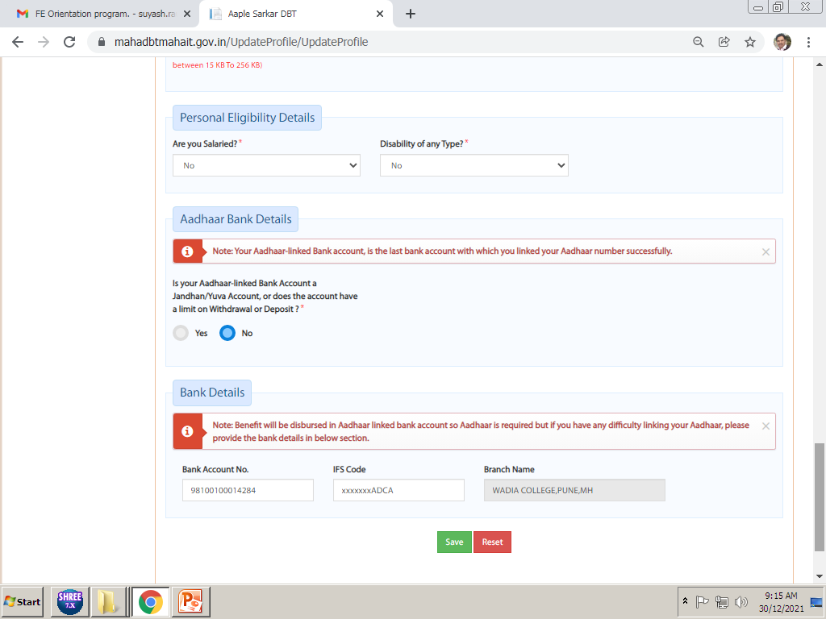
Check all previously filled data in personal information if no changes simply save and forward to next . Do not make any changes in income certificate. NO NEW INCOME CERTIFICATE REQUIRED FOR SC/ST/OBC/SBC/VJNT
Click on the Save option after update all these details, this will Save all personal details in Profile.

Slide 14
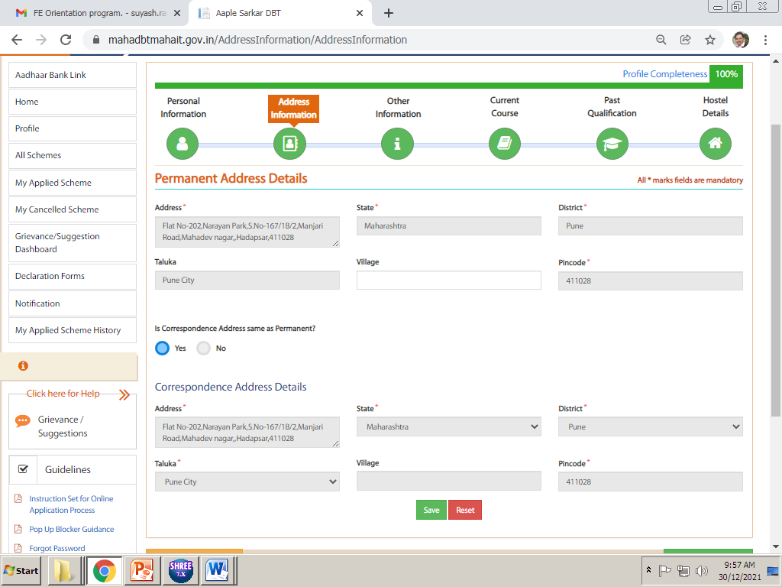
In this details students needs to update their Permanent Address and Correspondence Address details and Click on Save if no changes
Click on save

Slide 15
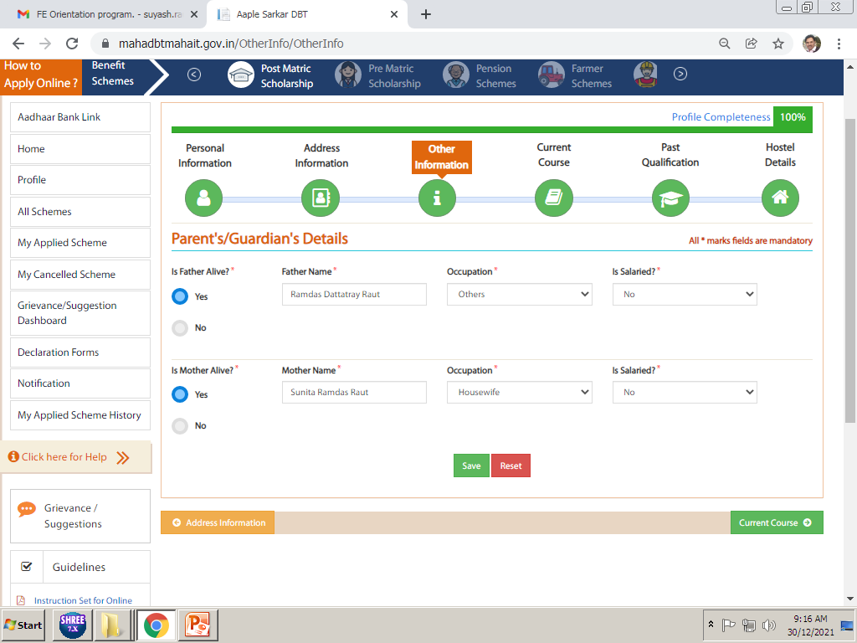
CLICK ON SAVE
In Other Information You have to select Parents Details. Occupation of Parents. Click on Save after update

Slide 16
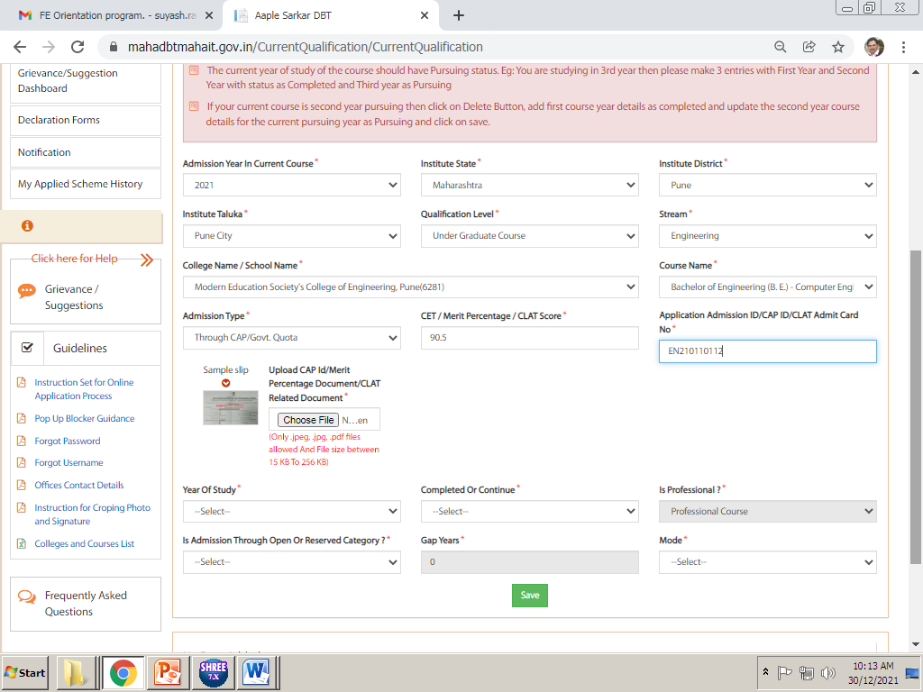
PUNE CITY
DIPLOMA COURSE
ENGINEERING
Cusrow Wadia Institute of Technology (aided)pune
Post s.s.c.diploma in enng(polytechnic)
10TH/12TH MARKS
DEN/DSD NO :
2021
For Second year :- Student must delete previously filled pursuing status then fill once again all these option with completed status & Upload Admission Confirmation Letter i.e. Allotment Letter in this CAP ID. Do not Upload freeze and confirm letter or any other document in this. Please see next slide for specimen copy for admission confirmation letter & then upload dec 24 & may 25 marksheet and both sem average marks.
For Third year students :- students must upload dec 24 and may 25marksheet with completed status do not delete first year both sem average marks.
After that for current year pursuing status fee paid zero and upload admission fee receipt do not upload bonafide even if it mentioned. If any student fill full fee i.e.7550 or 80000/80041 they can put here full fee.
Pune City
Modern Education Society’s College of Engineering(6281)
Notes:
Very Very Important Part of your form. These details must be 100% Accurate as per given in above picture

Slide 17
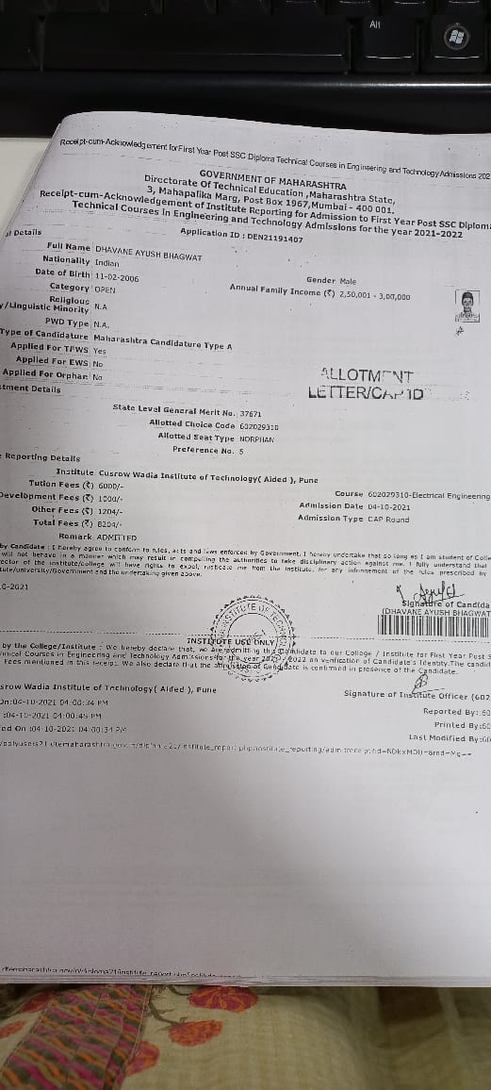
Specimen of allotment letter

Slide 18
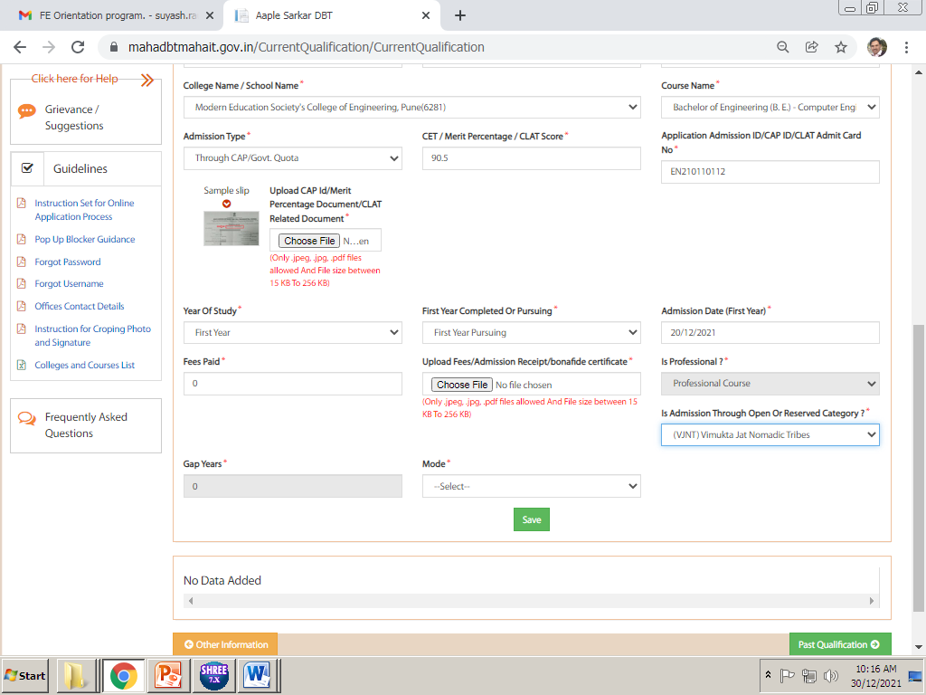
This is very important point of the Fees. You need to enter fees paid amount as “ 0 ” only.
Only Students who have paid Admission Fees Rs. 7550/- or 80000/-80041/-Can enter these amount in Fees Paid for refund of admission fees. (ONLY ST CATEGORY & SC category students those income above 2.50 lakh these STUDENTS CAN FILLUP Rs. 1550/10435/10075 paid)
Upload original Admission fees receipt at this point. Do not upload bonafide certificate select other details and click on Save.

Slide 19
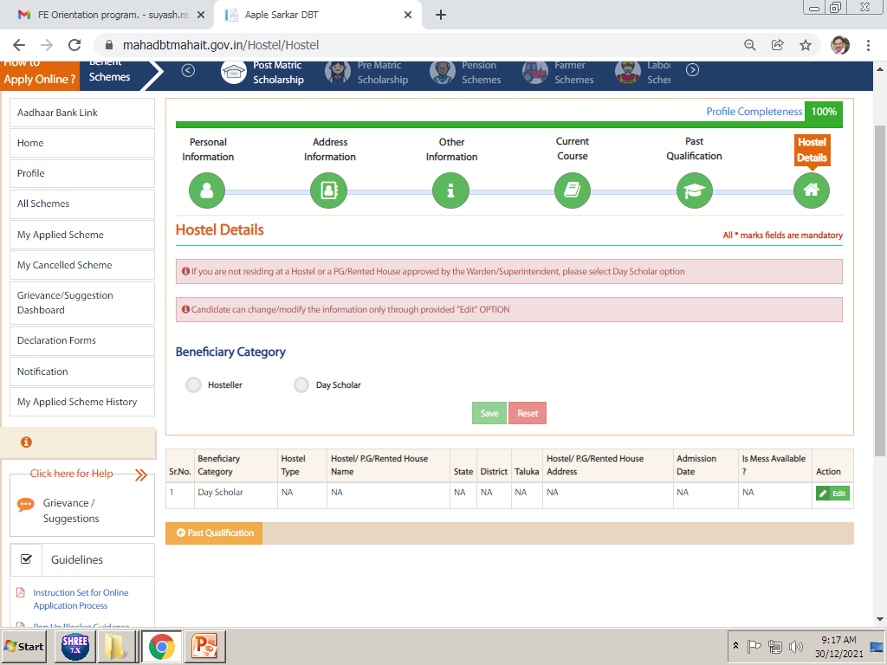
After update hostel details students profile is completed 100%, now he/she needs to apply for scheme as per his/her eligibility.
If Students Staying in Hostel then he/she need to update Hostel Information here, upload hostel receipt/rent agreement here.
(FOR VJNT/SBC VJNT HOSTEL SCHEME IS AVAILABLE students those income below Rs. 250000/- they can select this scheme option (only wadia college hostel allowed ) FOR SC CATEGORY SWADHAR HOSTEL SCHEME AVAILABLE FOR ST CATEGORY SWAYAM HOSTEL SCHEME AVAILABLE

Slide 20
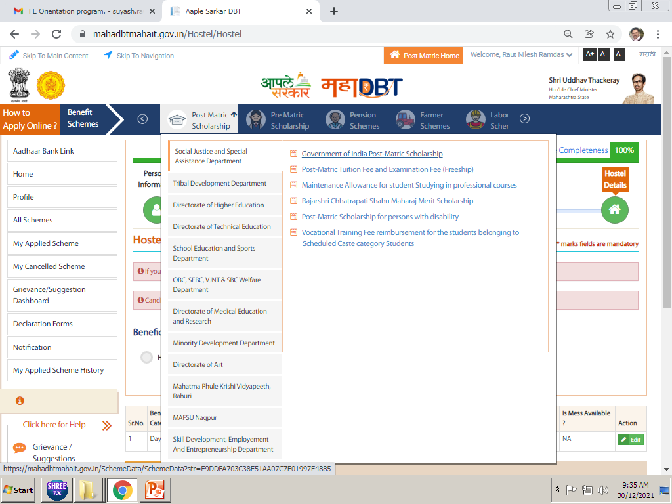
In all scheme tab, select your Department name and click on scheme name as per your eligibility. For detail see notice which is given in students grp / next slide.

Slide 21
Category wise and Income wise applicable schemes to be select.
Category | Parents Income | Department Name | Scheme Name
SC | Below 2.50 Lakh | Social Justice and Special Assistance dept. | Govt of India Post-Matric Scholarship
 | 250001 onwards ONLY CAP STUDENTS | Social Justice and Special Assistance dept. | Post Metric Tuition fee and Examination Fee (Freeship)
OBC, VJNT & SBC | Below 2.50 Lakh | OBC, SEBC, VJNT, and SBC welfare Department | Post Metric Scholarship to OBC/SBC/VJNT Students
 | 250001 onwards ONLY CAP STUDENTS | OBC, SEBC, VJNT, and SBC welfare Department | Tuition Fees and Examination Fees to OBC/SBC/VJNT Students
ST | Below 2.50 Lakh | Tribal Development Dept. | Govt. of India Post-Matric Scholarship.
 | 250001 onwards ONLY CAP STUDENTS | Tribal Development Dept. | Vocational Education Fee Reimbursement Scheme(Freeship)

Slide 22
Category wise and Income wise applicable hostel schemes to be select.
Category | Parents Income | Department Name | Scheme Name
SC | Below 2.50 Lakh marks above 60% | Swadhar scheme only for renewal
VJNT & SBC | Below 2.50 Lakh | VJNT, and SBC welfare Department (only wadia college hostel students can apply for this scheme) | Payment of Maintenance Allowance to VJNT and SBC Students Studying in Professional Courses and Living in Hostel Attached to Professional Colleges
ST | Below 2.50 Lakh marks above 60% | Swayam scheme

Slide 23
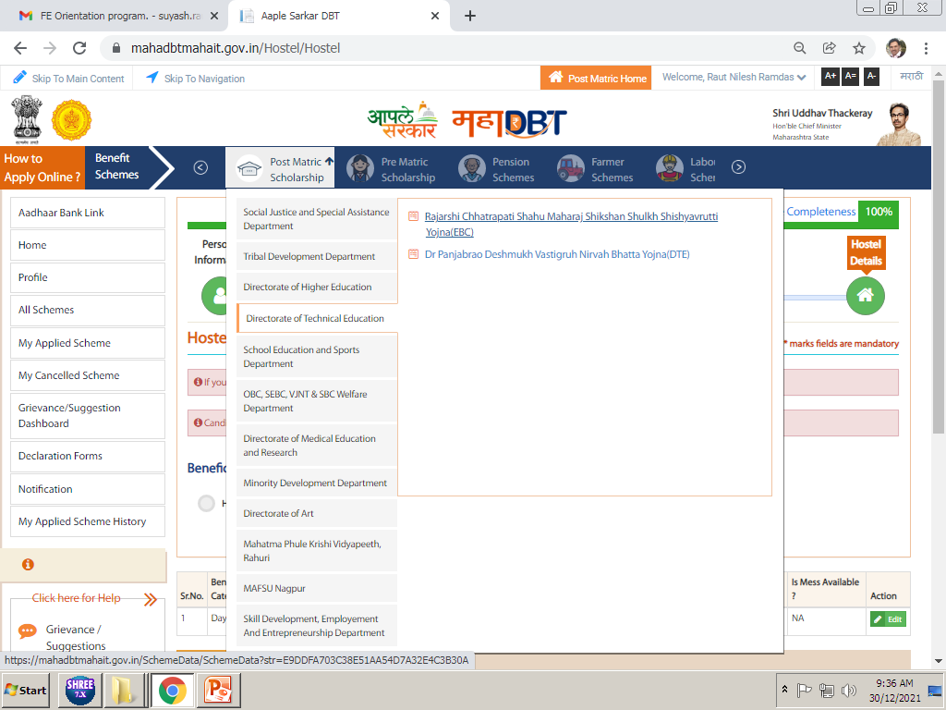
CLICK ON ALL SCHEME FOR APPLY ON MAHADBT PORTAL AFTER COMPLITION OF 100% PROFILE THEN SELECT PROPER SCHEME AS PER NOTICE GIVEN TO YOU

Slide 24
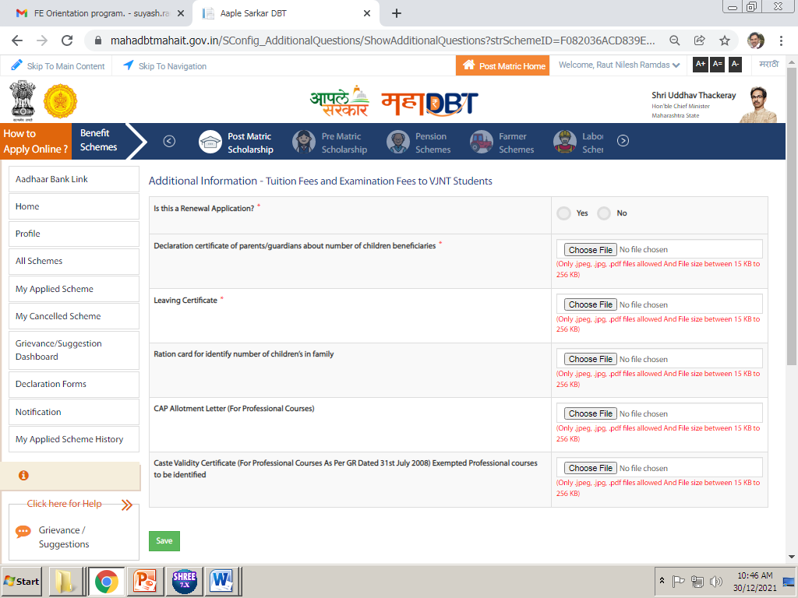
Is this renewal application students Select yes and write your previous application no . If you do not have no go to my applied scheme history here you select 2324 & see you application number
Mandatory to upload (undertaking)
Mandatory to upload Leaving & ration card & non crème .
upload allotment letter/cap id
Mandatory to upload only for ST freeship
After applying scheme, fill up above details. Upload all the required documents in above and click on save.
Imp Note. All documents Mentioned here are important and needs to be uploaded, failing to upload will result in rejection of your application.

Slide 25
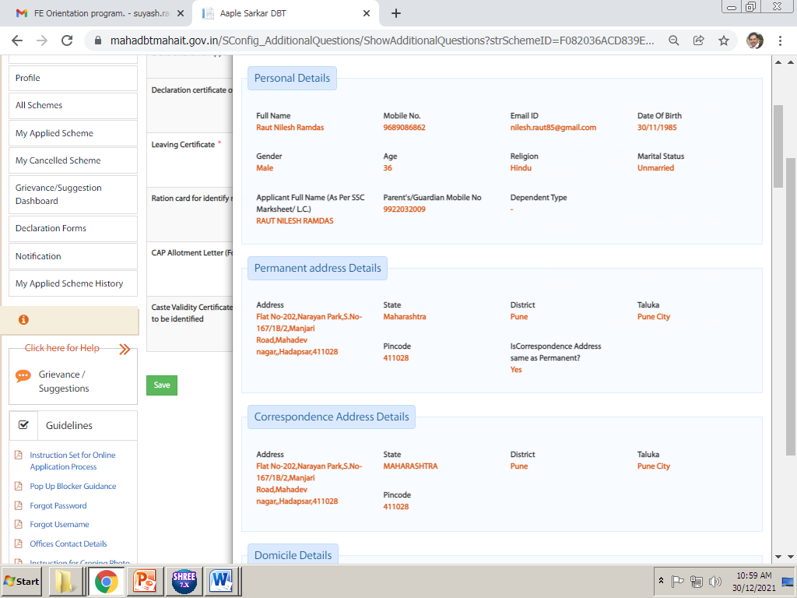
After click on the Save next page will come like this, verify all the details filled by you in this page, and scroll down to end for submission of application.

Slide 26
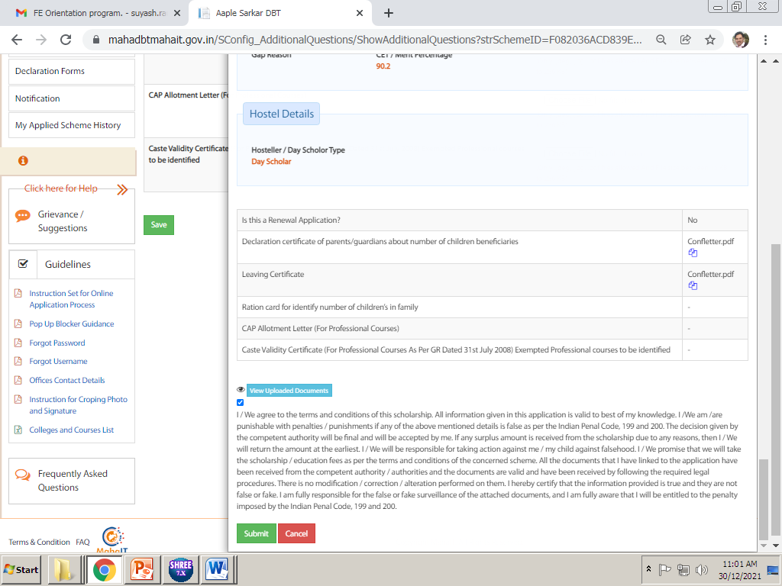
ENSURE YOUR UPLOADED DOCUEMNTS
Tick on that check box to submit the application and click on Submit Button to submit application.
ENSURE YOUR UPLOADED DOCUEMNTS
IMP NOTE :- PLEASE ENSURE YOUR UPLOADED DOCUEMNTS ONCE AGAIN THEN ONLY SUBMITE ONLINE After successful submission of online application you need to take printout or pdf copy of your application for submission to college with required documents.

Slide 27
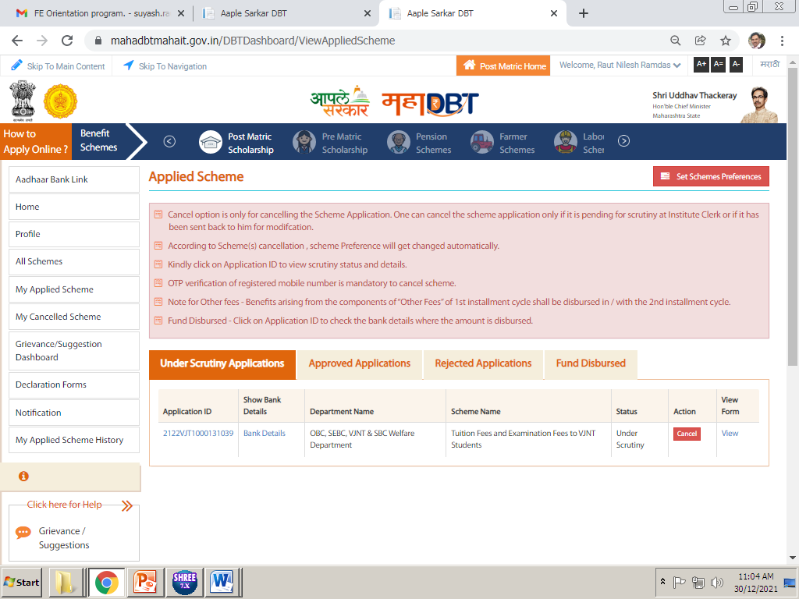
Click on My applied scheme
Click on view to take print out of form
For this go to My applied scheme and there you will find your application in Under Scrutiny tab, click on View in last column.

Slide 28
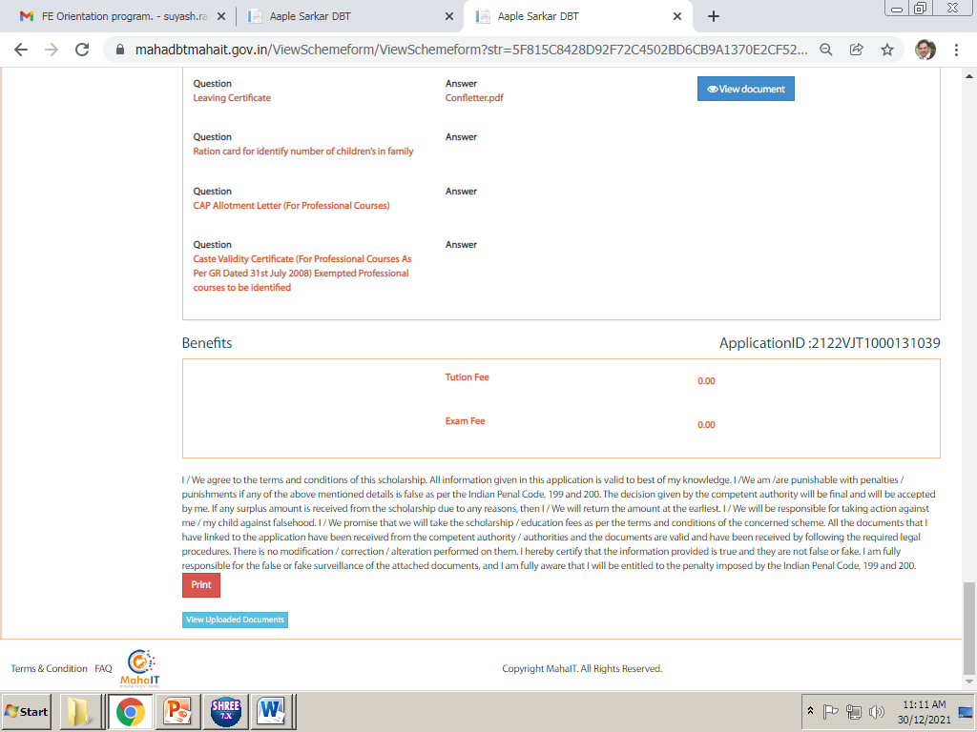
Click on print option to take printout or pdf copy of the form…

Slide 29
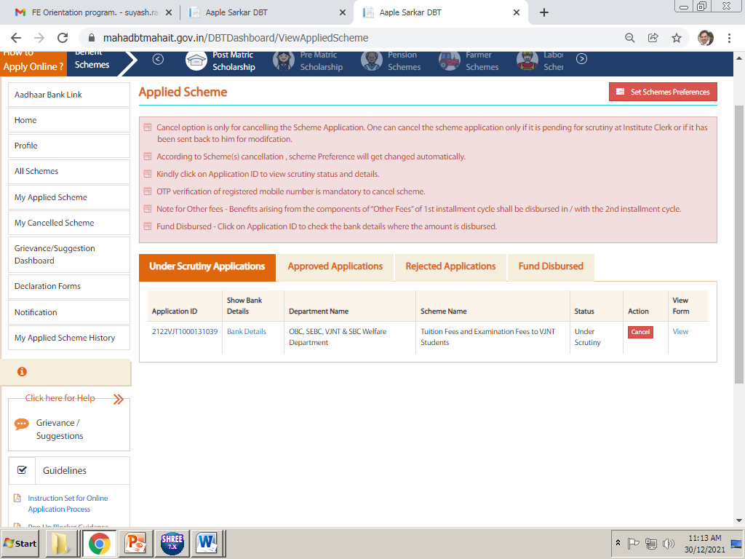
Click on my applied scheme for these details
If send back reapply button appear here
In My applied scheme, you will find all update i.e. send back or approved if send back you find message why your form is send back.

Slide 30
PUNE CITY
DIPLOMA COURSE
ENGINEERING
Cusrow Wadia Institute of Technology (aided)pune
Post s.s.c.diploma in enng(polytechnic)
10TH/12TH MARKS
DEN/DSD NO :
IF SEND BACK DUE TO ALLOTMENT LETTER OR FEE PAID ZERO THEN YOU HAVE TO DELETE PREVIOUS FILLED CONTENT THEN FILLED ALL DETAILS AGAIN.
2021
Upload Admission Confirmation Letter i.e. Allotment Letter in this CAP ID. Do not Upload freeze and confirm letter or any other document in this. Please see next slide for admission confirmation letter.
Pune City
Modern Education Society’s College of Engineering(6281)
Notes:
Very Very Important Part of your form. These details must be 100% Accurate as per given in above picture

Slide 31
CLICK THIS MENU FOR REAPLY OR SEND BACK
HERE GREEN BUTTON AVAILABLE HERE YOU HAVE TO CLICK FOR REAPLY

Slide 32
FOR REAPLY/SEND BACK YOU HAVE TO UPLOAD ONCE AGAIN ALL THESE DETAILS
Is this renewal application, FY/DSY students Select NO,
Mandatory to upload (undertaking)
Mandatory to upload ration card & leaving & non creme
upload allotment letter/cap id
Mandatory to upload only for ST freeship
After applying scheme, fill up above details. Upload all the required documents in above and click on save.
Imp Note. All documents Mentioned here are important and needs to be uploaded, failing to upload will result in rejection of your application.

