Slide 1
Modern Education Society’s
Cusrow Wadia Institute of Technology , Pune 01.
Scholarship Section.
Information on Scholarship schemes by Mrs. Sayali Kane.

Slide 2
MahaDBT Scholarship Schemes.
Instruction for Filling MahaDBT Scholarship / Freeship / EBC Forms.
1) Scholarship website is https://mahadbtmahait.gov.in
Important Note: - Before applying on Mahadbt portal, Scan your all original the documents in pdf format or jpg format size from 150kb to 250kb for uploading on MahaDBT portal for Application. Do not upload blur images; it may reject your application.

Slide 3
List of documents required for uploading on mahadbt site
Upload following doucments in personal information menu
Income Certificate (valid till 31.3.2026) from tahasildar. (All SEBC students must upload non crème along with income)income limit 8 lakh
Note :- If father is not alive then upload death certificate and upload mother income certificate
Note :- If separation upload affidavit of separation from mother
Domicile certificate
Caste certificate
Student adhar base bank account details

Slide 4
Follow following instruction carefully because your form may be rejected from Government
Upload following original documents in current year information
Delete previously pursuing details first then again fillup all information of previously filled with complited status for eg. Last year in 24-25 you are in first year the now your status is complited write both sem marks average & upload both dec 24 and may 25 marksheet
Note : Select your course proper especially mechanical and Electronics and Telecommunication students those who admitted in aided and unaided section because there is major difference in fees . Select Course Type Aided those admitted in aided section and Slect Course Type Unaided who admitted in unaided section
In CET Score you have write your 10th or 12 or ITI marks on which your admission is confirmed.
DTE Allotment letter Note :- Do not upload freeze confirm letter upload allotment letter which given by Institute.
Admission fee receipt. (Do not upload bonafide even if it mentioned) write fee paid zero
Note :-Those who paid full fee i.e. Rs.7550(aided) & Rs.80000/80041(unaided) they can write full amount.

Slide 5
Upload Following Documents in Hostel details menu:- Hostel fee receipt ( do not upload online copy proper fee receipt required) and Hostel Certificate of warden/ Rent agreement + light bill of owner+ adhar card of student & owner.

Slide 6
Upload all these original documents in all scheme menu
Undertaking
Leaving certificate (latest)
Ration card xerox & non crème (for sebc)
Current year Alpa bhu darkh dakhla or Register labour document for hostel scholarship ( any one)(if these documents are not available then select no it is not mandetory to upload.

Slide 7
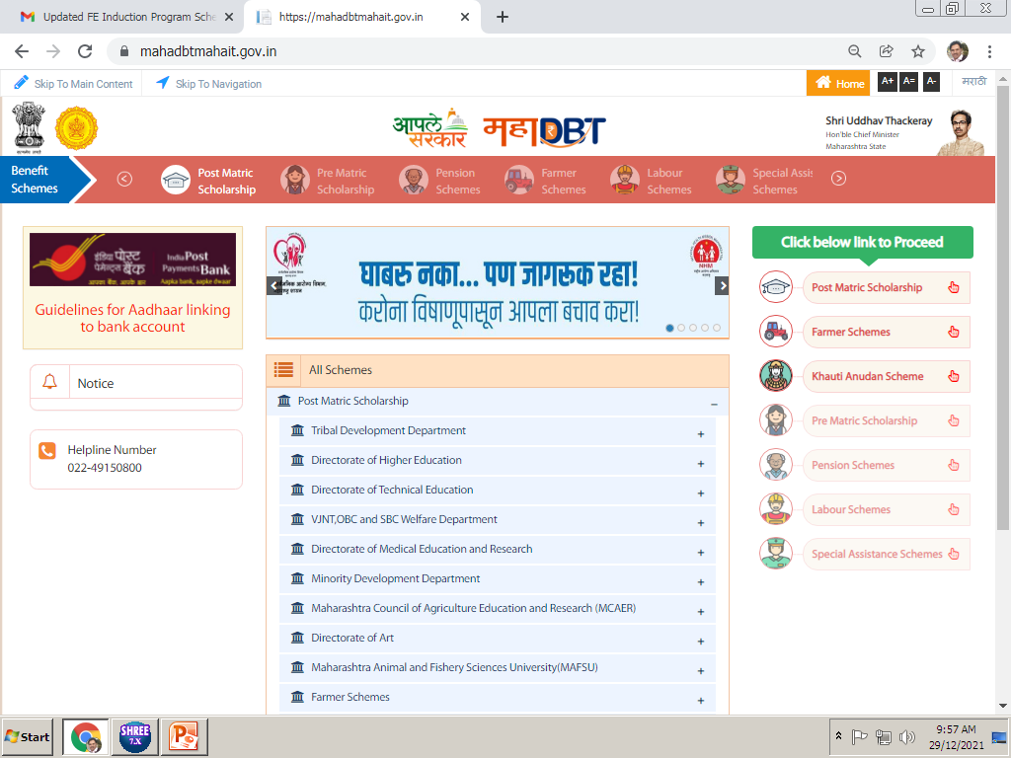
Click on the Post Matric Scholarship

Slide 8
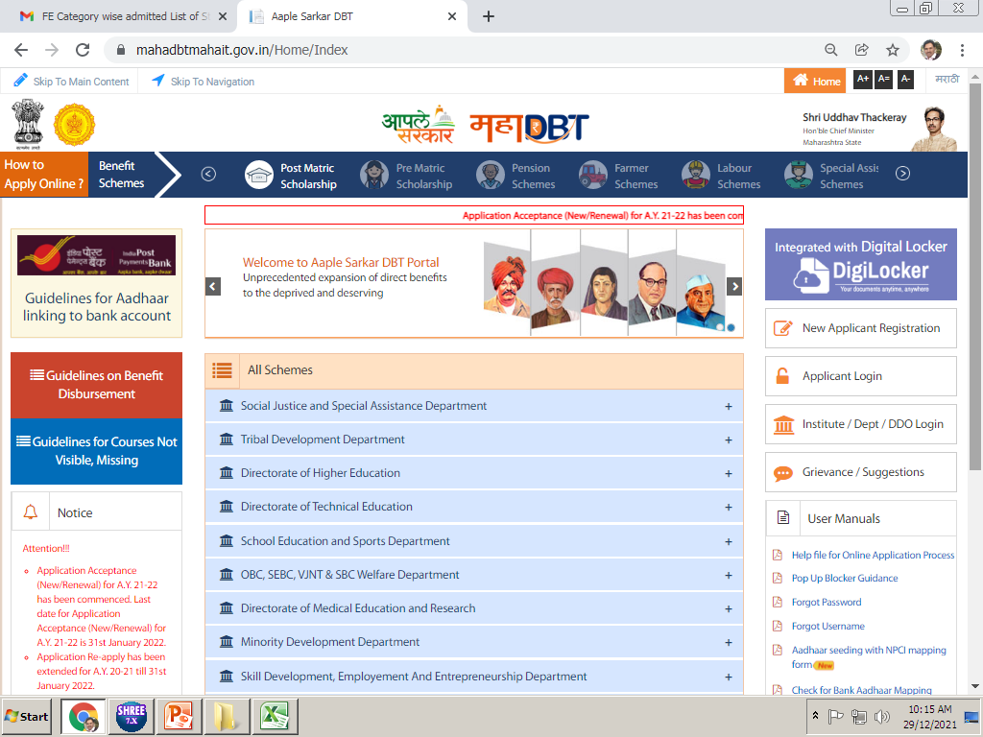
If you have filled this form in previous Academic year, you need to use applicant login option.

Slide 9
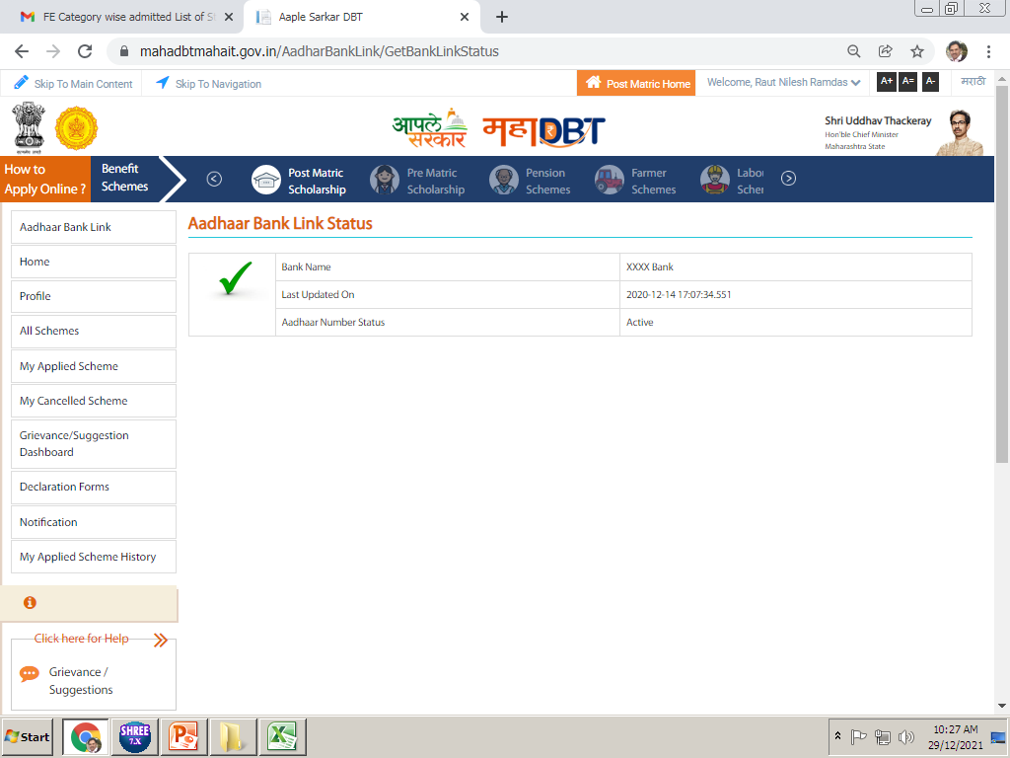
Click on the Profile option…

Slide 10
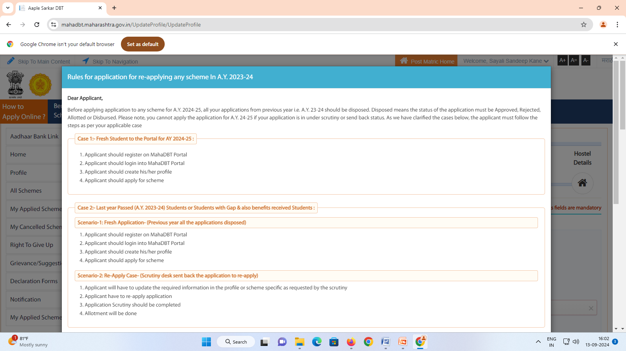
READ ALL INSTRUCTIONS CAREFULLY

Slide 11
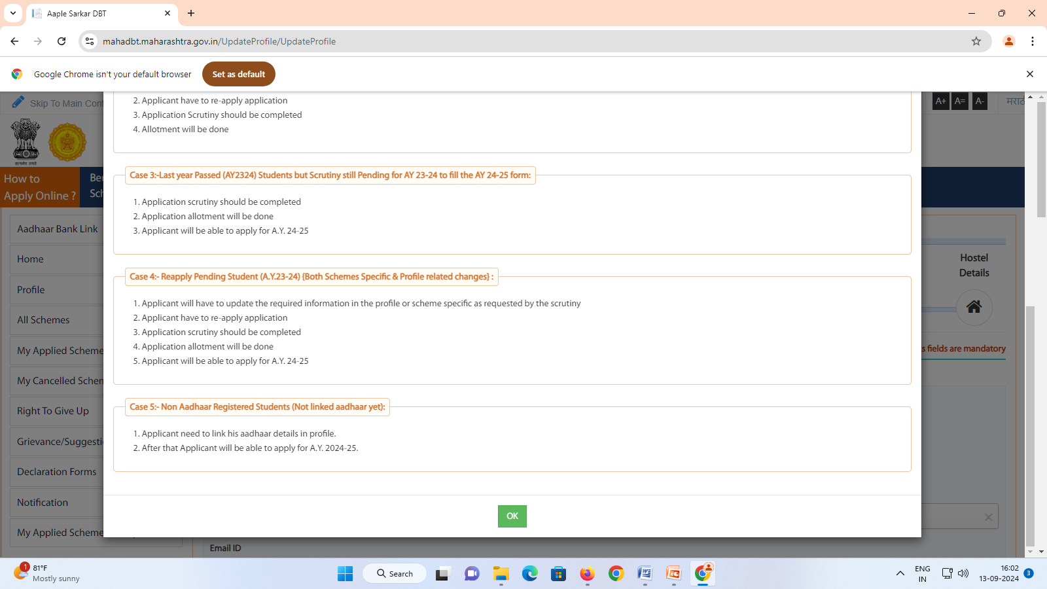
CLICK ON OK

Slide 12
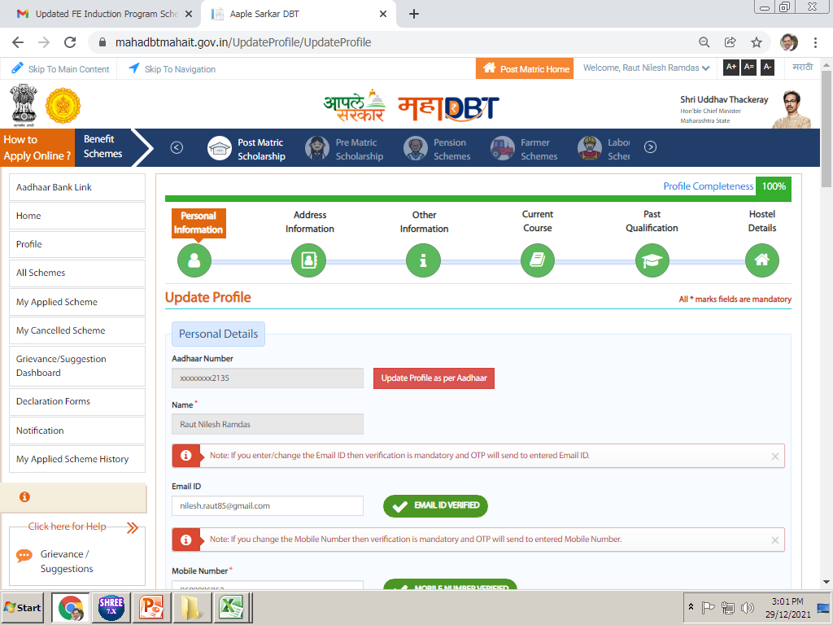
Click on update profile as per adhar
Notes:
Here we have to create our students profile in this option. Profile is distributed in six parts. We have to update all these six parts of Profile.

Slide 13
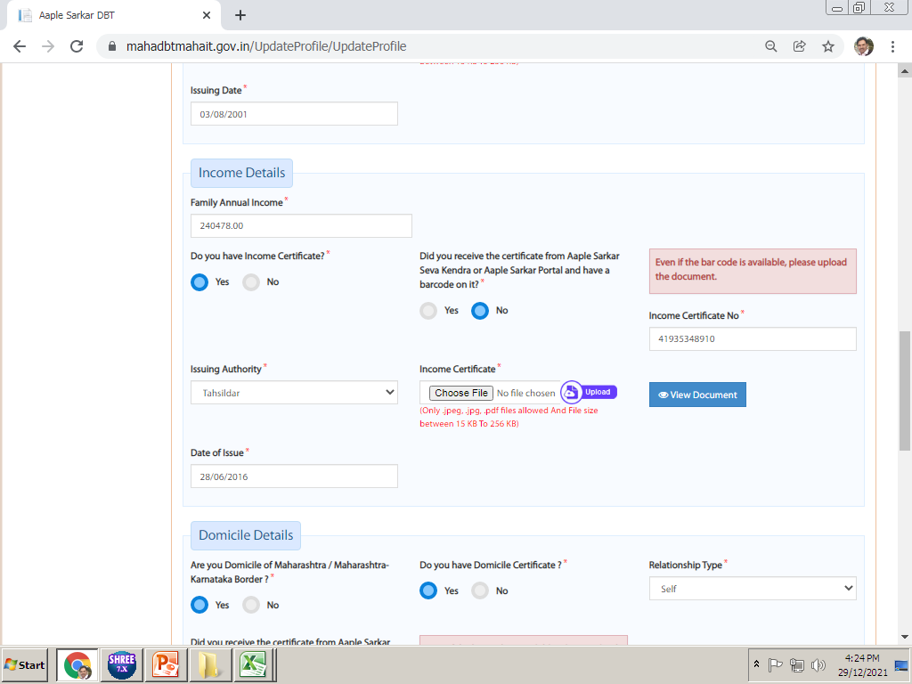
Income details :- In these details, student need to update their Income certificate details. SEBC student musat upload noncreme + income
Enter your Parents Annual income here
Upload Income certificate of your father of FY 2024-25. (valid upto march26) In case Income certificate of Mother, Upload supporting documents with Income certificate like death certificate of father or if separation upload affidavit. if any… (Scan both documents in single file and upload)

Slide 14
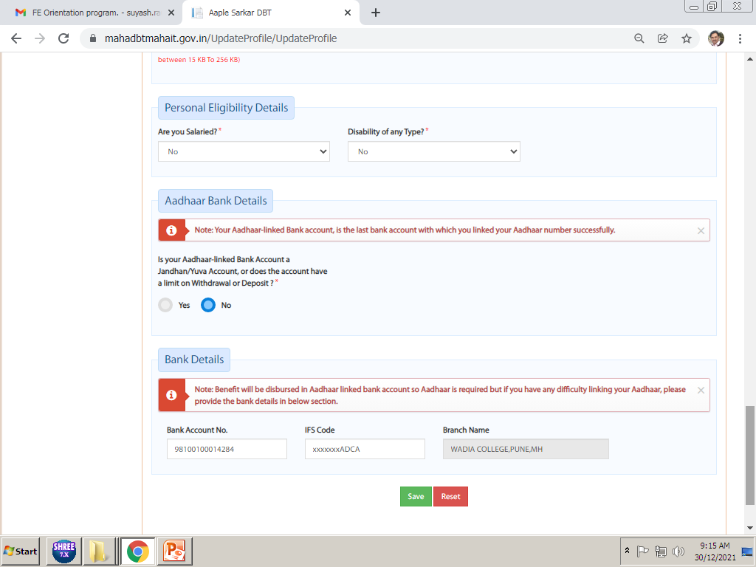
Enter personal eligibility details, and check Bank details students adhar must link with bank here…
Click on the Save option after update all these details, this will Save all personal details in Profile.

Slide 15
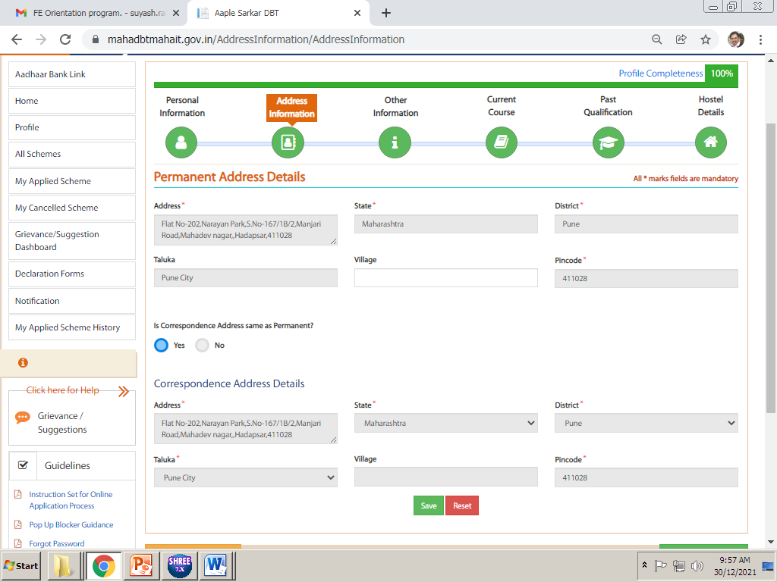
In this details students needs to update their Permanent Address and Correspondence Address details and Click on Save.
Click on save

Slide 16
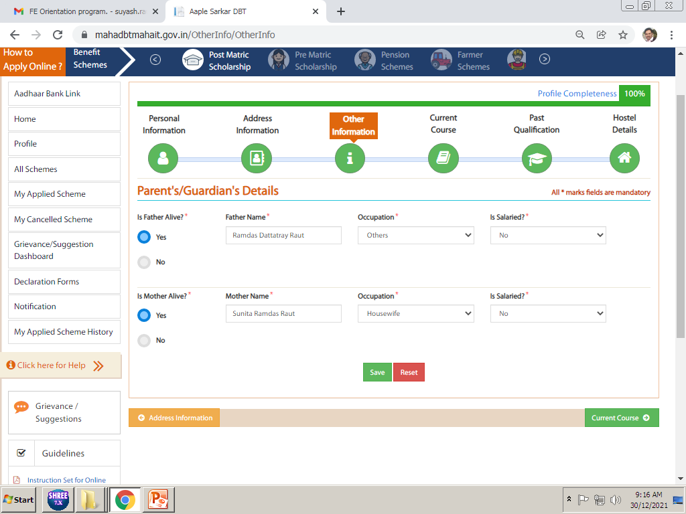
CLICK ON SAVE
In Other Information You have to select Parents Details. Occupation of Parents. Click on Save after update

Slide 17
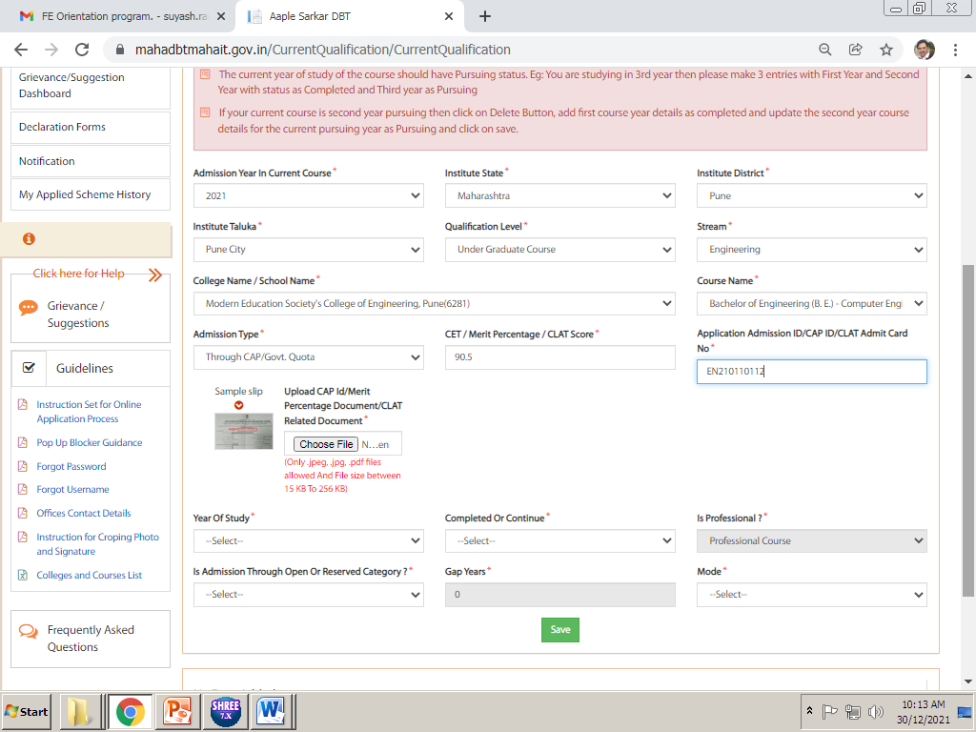
PUNE CITY
DIPLOMA COURSE
ENGINEERING
Cusrow Wadia Institute of Technology (aided)pune
Post s.s.c.diploma in enng(polytechnic)
10TH/12TH MARKS
DEN/DSD NO :
2021
For Second year :- Student must delete previously filled pursuing status then fill once again all these option with completed status & Upload Admission Confirmation Letter i.e. Allotment Letter in this CAP ID. Do not Upload freeze and confirm letter or any other document in this. Please see next slide for specimen copy for admission confirmation letter & then upload dec 24 & may 25 marksheet and both sem average marks.
For Third year students :- students must upload dec 24 and may 25marksheet with completed status do not delete first year both sem average marks.
After that for current year pursuing status fee paid zero and upload admission fee receipt do not upload bonafide even if it mentioned. If any student fill full fee i.e.7550 or 80000/80041 they can put here full fee.
Pune City
Modern Education Society’s College of Engineering(6281)
Notes:
Very Very Important Part of your form. These details must be 100% Accurate as per given in above picture

Slide 18
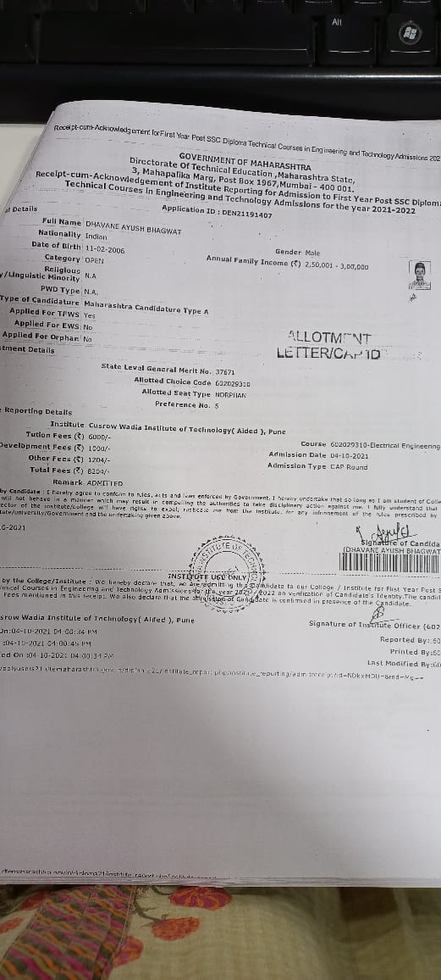
Specimen of allotment letter

Slide 19
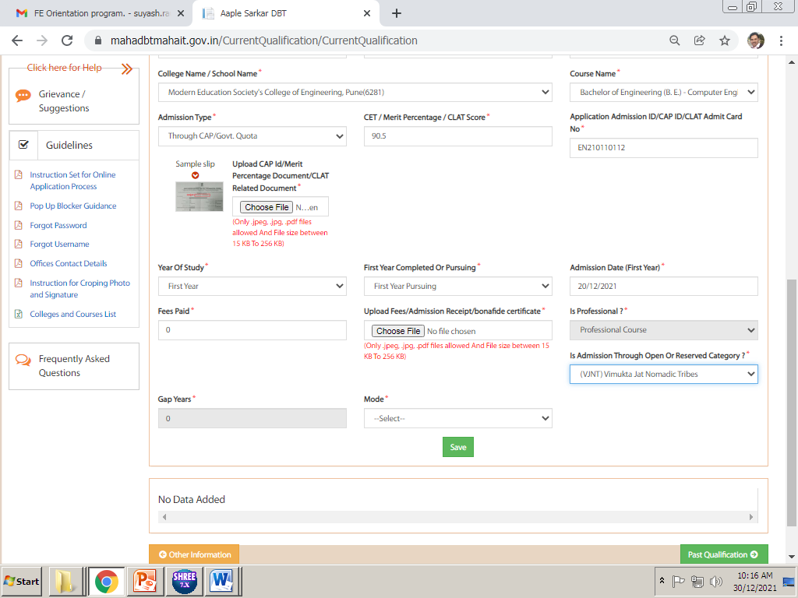
This is very important point of the Fees. You need to enter fees paid amount as “ 0 ” only.
Only Students who have paid Admission Fees Rs. 7550/- or 80000/-80041/-Can enter these amount in Fees Paid for refund of admission fees.
Upload original Admission fees receipt at this point. Do not upload bonafide certificate select other details and click on Save.

Slide 20
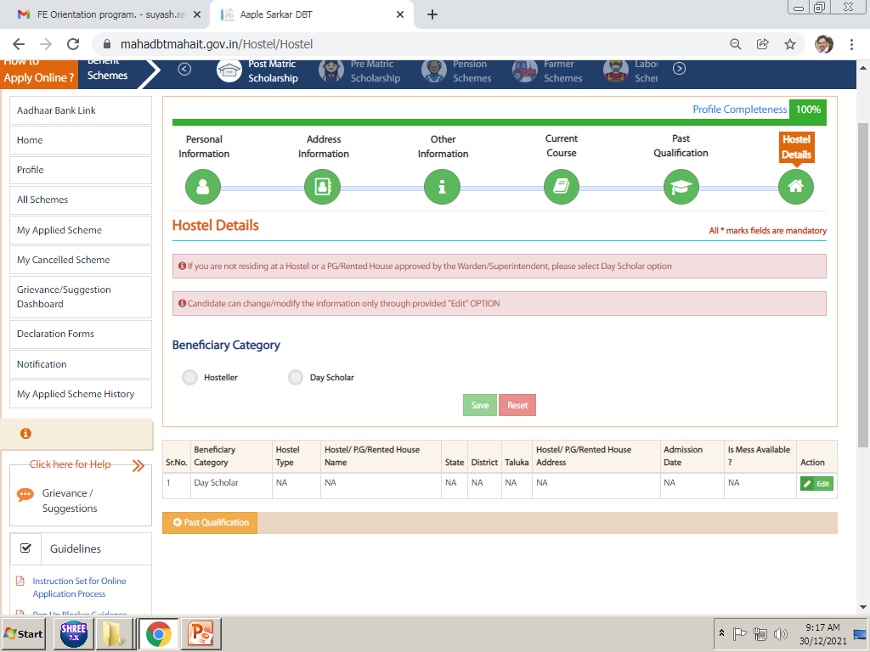
After update hostel details students profile is completed 100%, now he/she needs to apply for scheme as per his/her eligibility.
If Students Staying in Hostel then he/she need to update Hostel Information here, upload hostel receipt/rent agreement here.
For Hostel Scheme benefits, it is mandatory to update these details (only for ebc/panjabrao deshmukh)

Slide 21
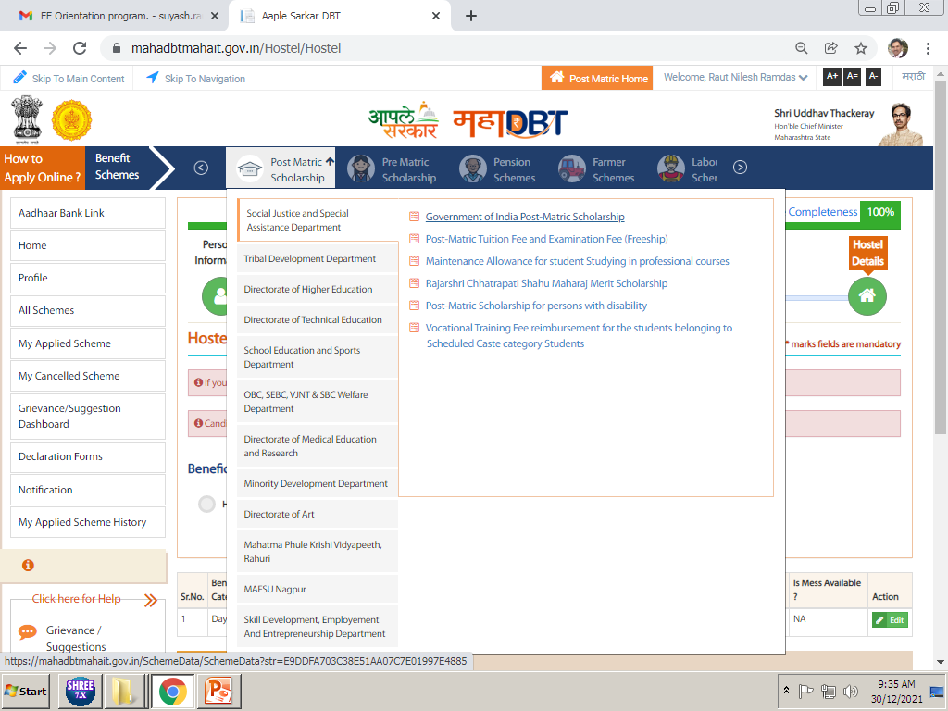
In all scheme tab, select your Department name and click on scheme name as per your eligibility.

Slide 22
Category wise and Income wise applicable schemes to be select.
Category | Parents Income | Department Name | Scheme Name
OPEN, SEBC,EWS | Below 8 Lakh | Directorate of Technical Education | Rajashri Chatrapati Shahu Maharaj Fee Reimbursement Scheme

Slide 23
Category wise and Income wise applicable hostel schemes to be select.
Category | Parents Income | Department Name | Scheme Name
OPEN, SEBC,EWS | Below 8 Lakh | Directorate of Technical Education | Panjabrao deshmukh scholarship

Slide 24
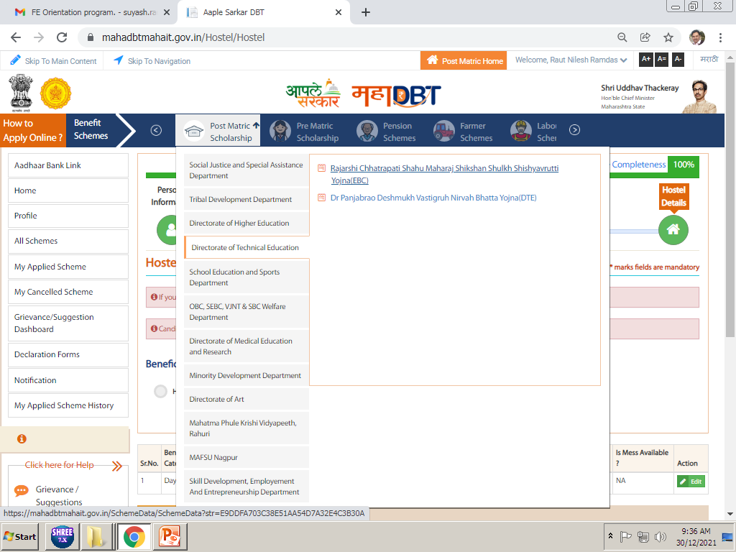
CLICK ON ALL SCHEME FOR APPLY ON MAHADBT PORTAL AFTER COMPLITION OF 100% PROFILE THEN SELECT PROPER SCHEME AS PER NOTICE GIVEN TO YOU

Slide 25
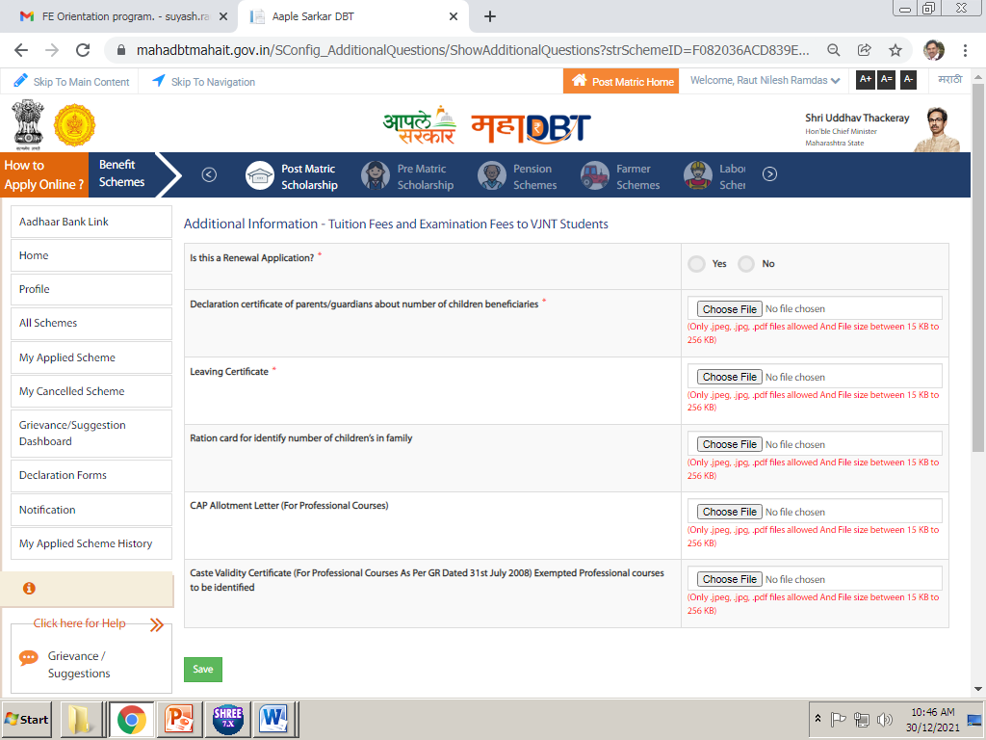
Is this renewal application, FY/DSY students Select NO,
Mandatory to upload (undertaking)
Mandatory to upload leaving& ration card & non crème for sebc
upload allotment letter/cap id
Mandatory to upload only for ST freeship
After applying scheme, fill up above details. Upload all the required documents in above and click on save.
Imp Note. All documents Mentioned here are important and needs to be uploaded, failing to upload will result in rejection of your application.

Slide 26
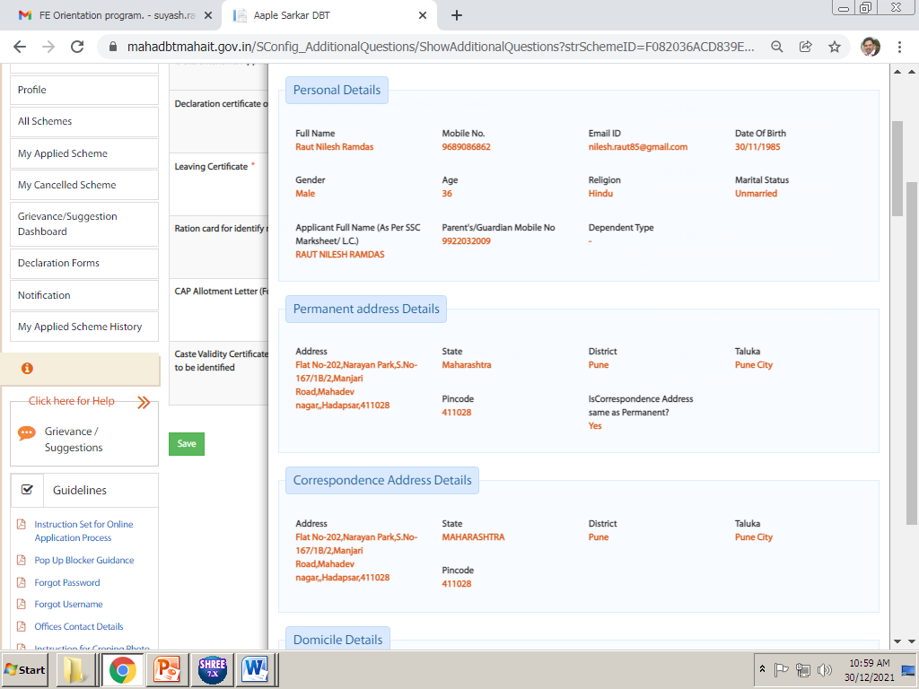
After click on the Save next page will come like this, verify all the details filled by you in this page, and scroll down to end for submission of application.

Slide 27
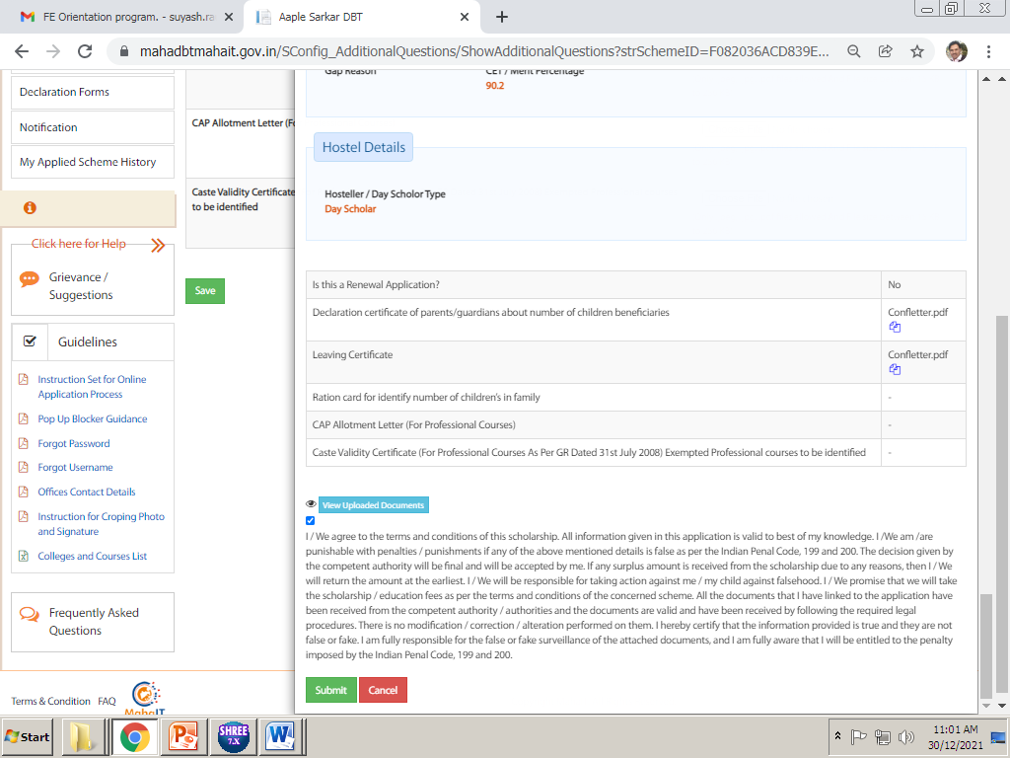
ENSURE YOUR UPLOADED DOCUEMNTS
Tick on that check box to submit the application and click on Submit Button to submit application.
ENSURE YOUR UPLOADED DOCUEMNTS
IMP NOTE :- PLEASE ENSURE YOUR UPLOADED DOCUEMNTS ONCE AGAIN THEN ONLY SUBMITE ONLINE After successful submission of online application you need to take printout or pdf copy of your application for submission to college with required documents.

Slide 28
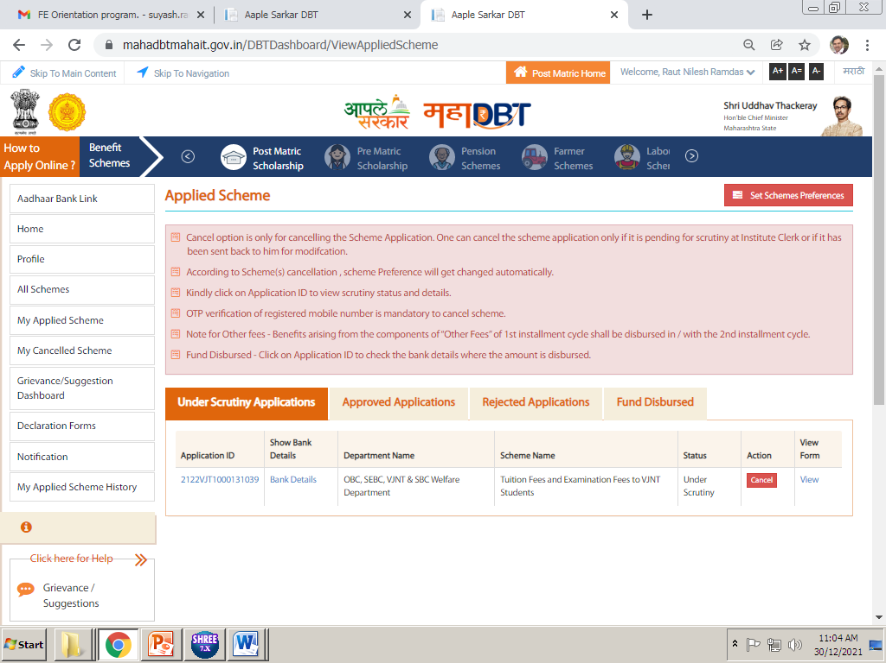
Click on My applied scheme
Click on view to take print out of form
For this go to My applied scheme and there you will find your application in Under Scrutiny tab, click on View in last column.

Slide 29
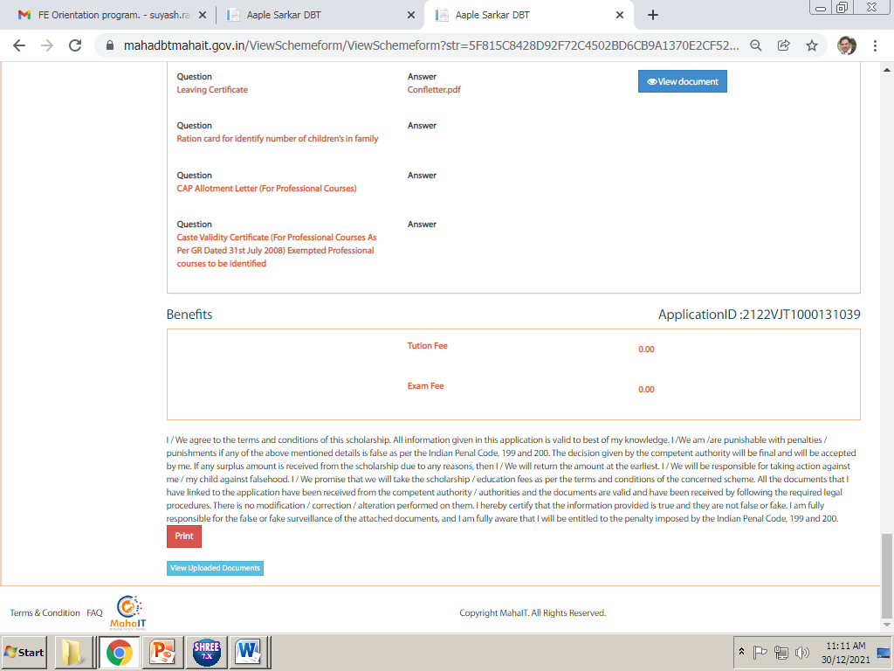
Click on print option to take printout or pdf copy of the form…

Slide 30
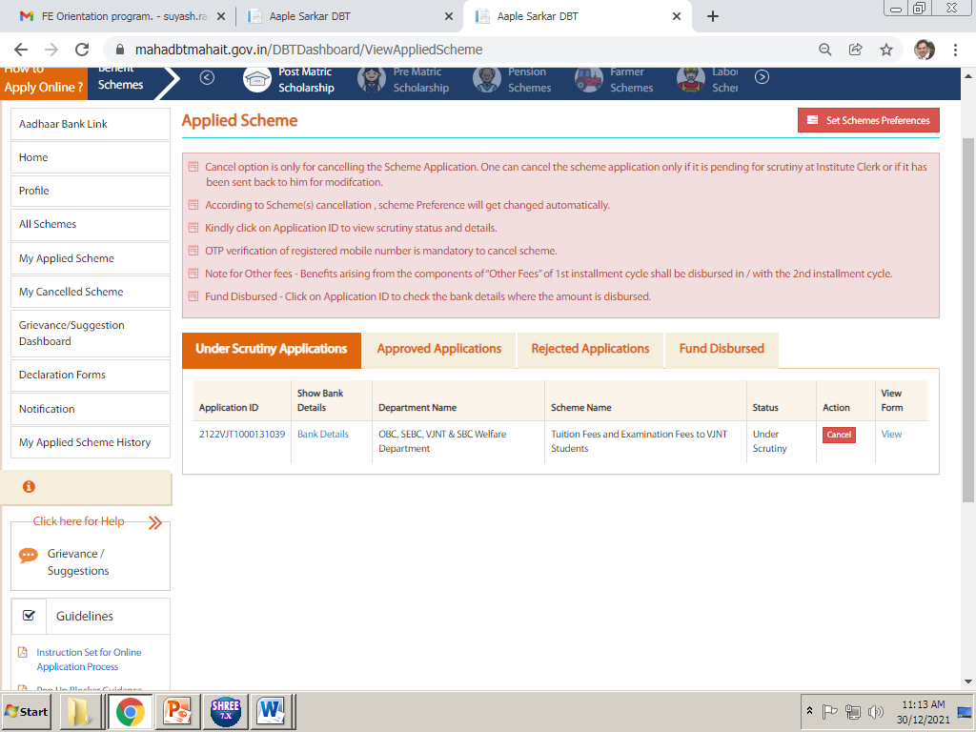
Click on my applied scheme for these details
If send back reapply button appear here
In My applied scheme, you will find all update i.e. send back or approved if your form is send back then here you can see why your form is send back then complete required documents and save and submit it once again.

Slide 31
PUNE CITY
DIPLOMA COURSE
ENGINEERING
Cusrow Wadia Institute of Technology (aided)pune
Post s.s.c.diploma in enng(polytechnic)
10TH/12TH MARKS
DEN/DSD NO :
IF SEND BACK DUE TO ALLOTMENT LETTER OR FEE PAID ZERO THEN YOU HAVE TO DELETE PREVIOUS FILLED CONTENT THEN FILLED ALL DETAILS AGAIN.
2021
Upload Admission Confirmation Letter i.e. Allotment Letter in this CAP ID. Do not Upload freeze and confirm letter or any other document in this. Please see next slide for admission confirmation letter.
Pune City
Modern Education Society’s College of Engineering(6281)
Notes:
Very Very Important Part of your form. These details must be 100% Accurate as per given in above picture

Slide 32
CLICK THIS MENU FOR REAPLY OR SEND BACK
HERE GREEN BUTTON AVAILABLE HERE YOU HAVE TO CLICK FOR REAPLY

Slide 33
FOR REAPLY/SEND BACK YOU HAVE TO UPLOAD ONCE AGAIN ALL THESE DETAILS
Is this renewal application, FY/DSY students Select NO,
Mandatory to upload (undertaking)
Mandatory to upload Leaving certificate, ration card, non crème for sebc
upload allotment letter/cap id
Mandatory to upload only for ST freeship
After applying scheme, fill up above details. Upload all the required documents in above and click on save.
Imp Note. All documents Mentioned here are important and needs to be uploaded, failing to upload will result in rejection of your application.

