Slide 1
Modern Education Society’s
Cusrow Wadia Institute of Technology , Pune 01.
Scholarship Section.
Information on Scholarship schemes by Mrs. Sayali Kane.

Slide 2
MahaDBT Scholarship Schemes.
Instruction for Filling MahaDBT Scholarship / Freeship / EBC Forms.
1) Scholarship website is https://mahadbtmahait.gov.in
Important Note: - Before applying on Mahadbt portal, Scan your all original the documents in pdf format or jpg format size from 150kb to 250kb for uploading on MahaDBT portal for Application. Do not upload blur images; it may reject your application.

Slide 3
List of documents required for uploading on mahadbt site
Upload following doucments in personal information menu
Income Certificate (valid till 31.3.2026) from tahasildar Note :- If father is not alive then upload death certificate and upload mother income certificate Note :- If separation upload affidavit of separation from mother
Note :- Students who admitted in against cap institute level admission & those income who belongs to SC category below Rs.250000/- & for OBC/SBC/VJNT below Rs.150000/- they can apply for scholarship on mahadbt portal
Domicile certificate/Adhivas pramanpatra (student) Rahivasi dakhala chalnar nahi
Caste certificate (student)
Student adhar base nationalise bank account details(student)

Slide 4
Follow following instruction carefully because your form may be rejected from Government
Upload following documents in current year information
Select your course proper especially mechanical and Electronics and Telecommunication students those who admitted in aided and unaided section because there is major difference in fees . Select Course Type Aided those admitted in aided section and Slect Course Type Unaided who admitted in unaided section
In CET Score you have write your 10th or 12 or ITI marks on which your admission is confirmed.
DTE Allotment letter Note :- Do not upload freeze confirm letter upload allotment letter which given by Institute on pink paper for aided & yellow paper for unaided
Admission fee receipt. (Do not upload bonafide even if it mentioned) write fee paid zero
Note :-Those who paid full fee i.e. Rs.8204/7984(aided) & Rs.80695/80475(unaided) they can write full amount.
Note:- Only St category students must write fee paid Rs.2204/1984(aided) & Rs.10729/10869.

Slide 5
Upload in Pass Qualification menu
Note :if any gap upload Gap certificate
10th marksheet (for CBSC and ICSC conversion marksheet and board marksheet)
12th marksheet /ITI MARKSHEET (only for dsy. Student who pass 12th and admitted in FY these students are not eligible for scholarship even if they didn’t taken it in 11th & 12th as per Government norms.
Upload Following Documents in Hostel details menu:- Hostel fee receipt ( do not upload online copy proper fee receipt required) and Hostel Certificate of warden/ Rent agreement + light bill of rented hous + adharcard of student & owner.

Slide 6
UPLOAD ALL THESE ORIGINAL DOCUMENTS IN ALL SCHEME MENU
Undertaking
Leaving certificate (latest)
Ration card xerox
In caste validty column upload students caste certificate Note : Only ST student whose income is above Rs.250000 they must upload caste validity other than ST they can upload caste certificate
Current year Alpa bhu darkh dakhla or Register labour document for hostel scholarship ( any one) it is not mandetory only hostel certificate also can get scholarship of hostel.

Slide 7
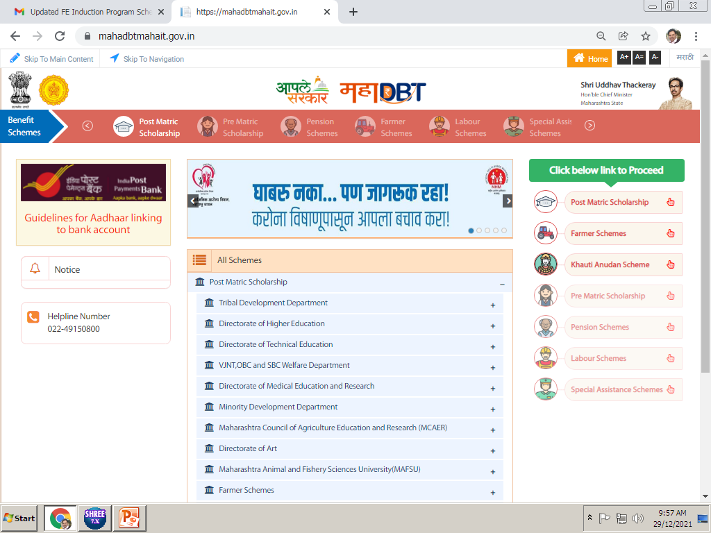
Click on the Post Matric Scholarship

Slide 8
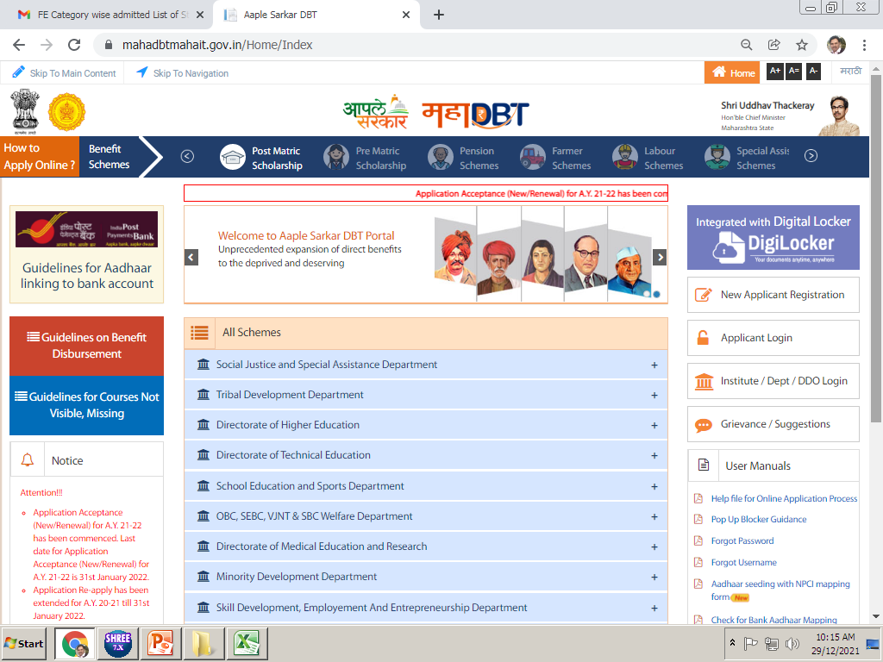
Click on New Registration, if you are filling this form first time.

Slide 9
If you have filled this form in previous Academic year, you need to use applicant login option.

Slide 10
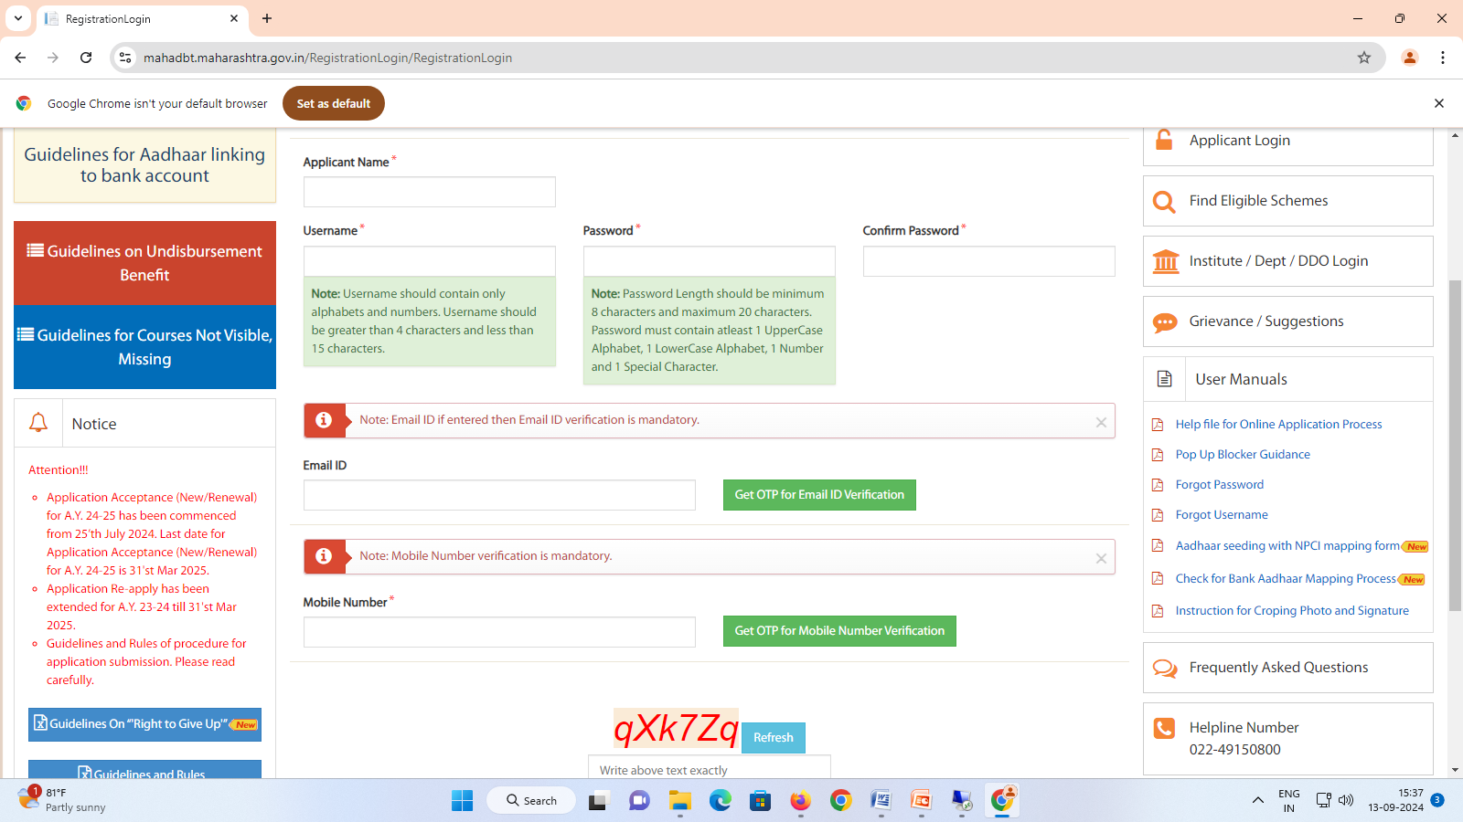
ENTER STUDENTS NAME AS PER ADHAR CARD
ENTER EMAIL ID AND GET VERFIED
STUDENTS MUST PRESERVE ID PASSWORD CAREFULLY TILL COMPLITION OF EDUCATION

Slide 11
Now use applicant login details

Slide 12
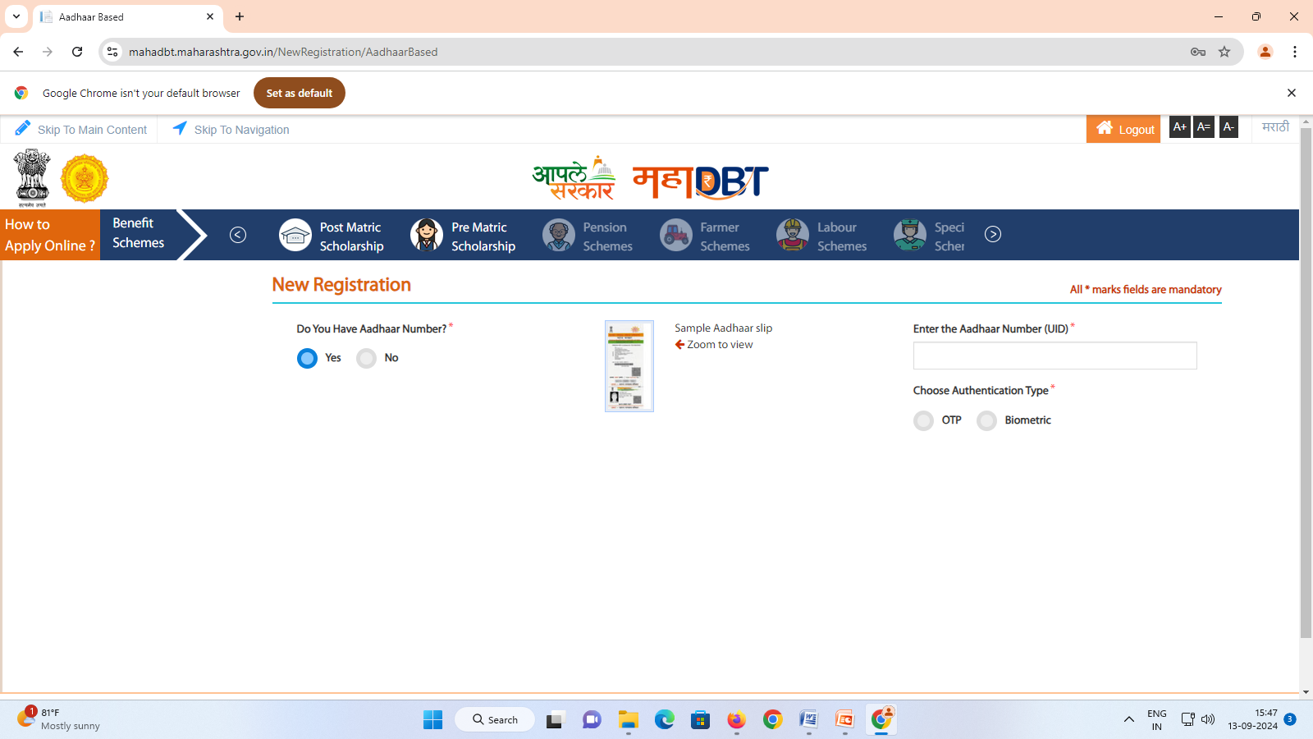
SELECT YES
ENTER STUDENTS ADHAR NO AND GET OTP ON ADHAR BASE MOBILE NUMBER. STUDENTS BANK ACCOUNT ALSO MUST LINK WITH THIS MOBILE NO. IF NOT GOVERNMENT WILL NOT DISBURSE SCHOLARSHIP TO STUDENT THEN STUDENT HAVE TO PAY PENDING FEE SO BE CAREFULL

Slide 13
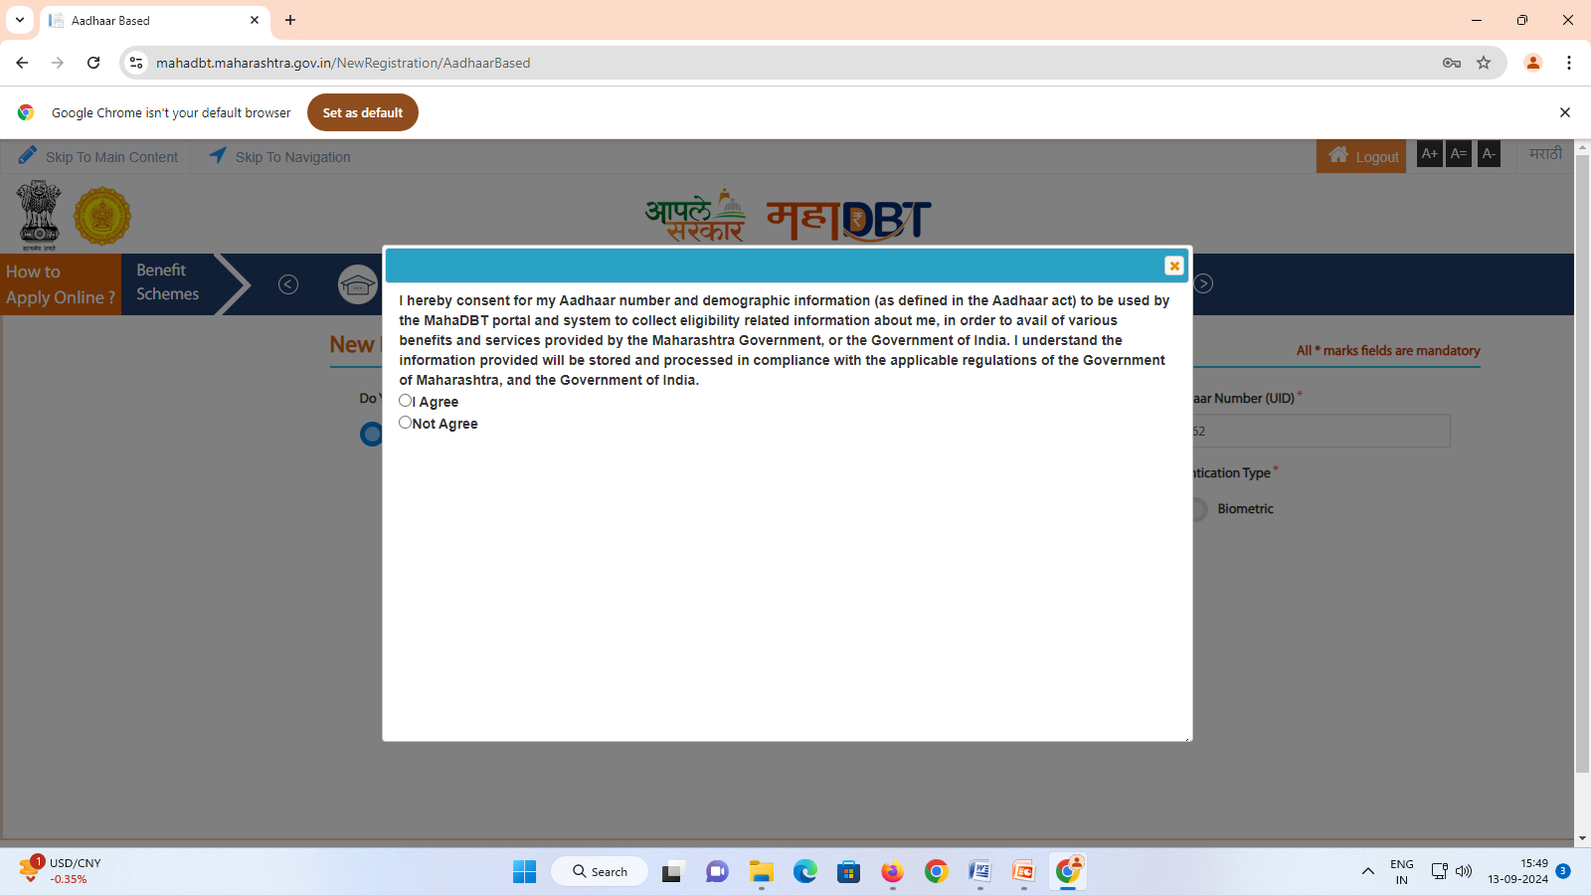
SELECT I AGREE

Slide 14
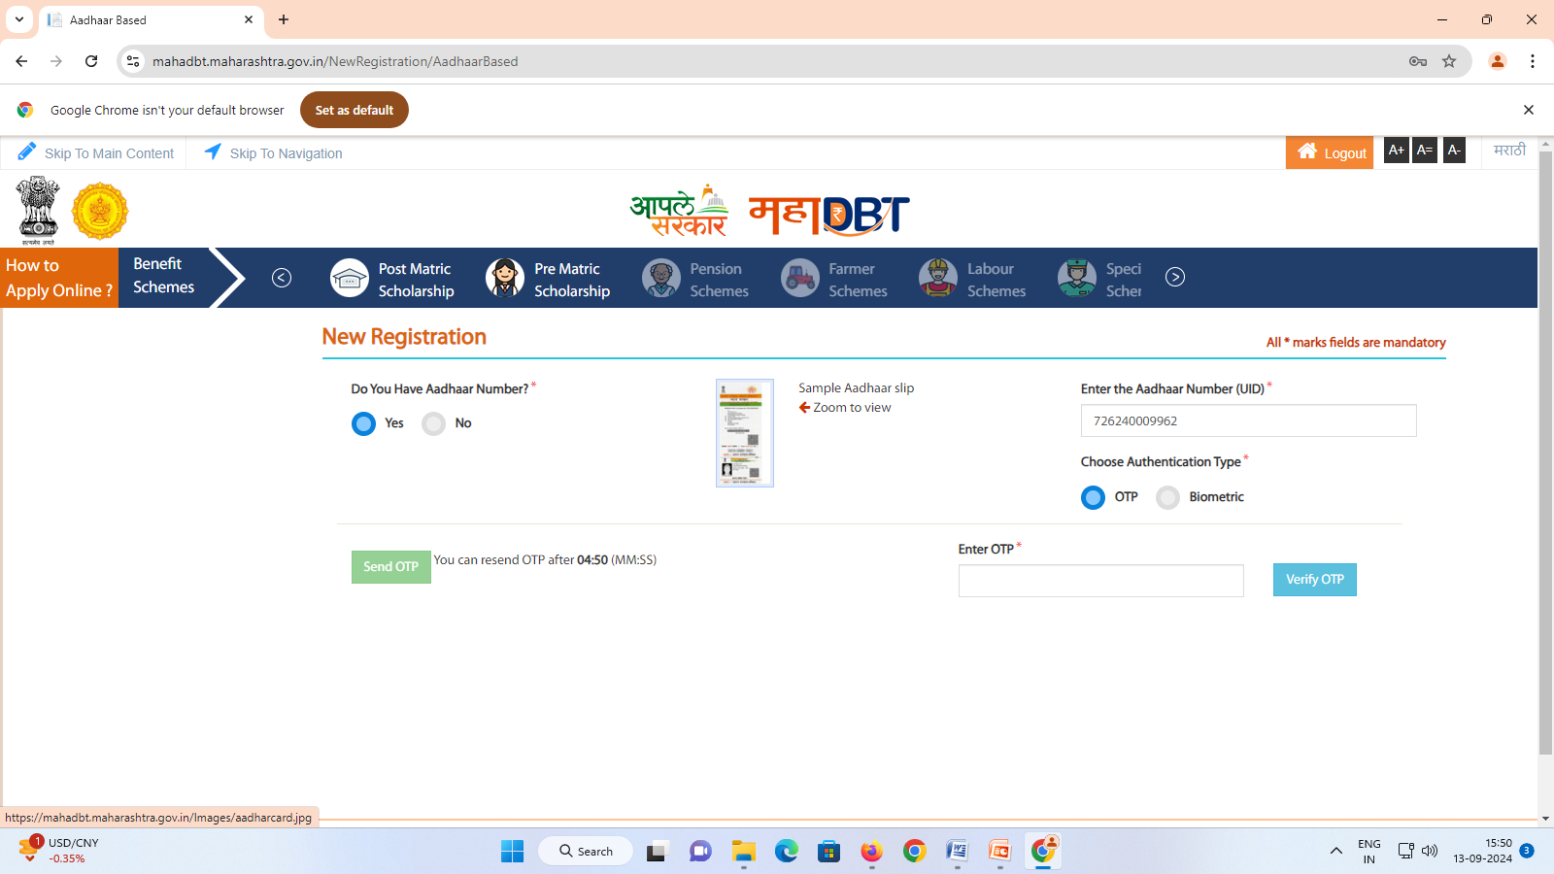
ENTER OTP ON WHICH YOU GET ON ADHAR BASE MOBILE NUMBER

Slide 15
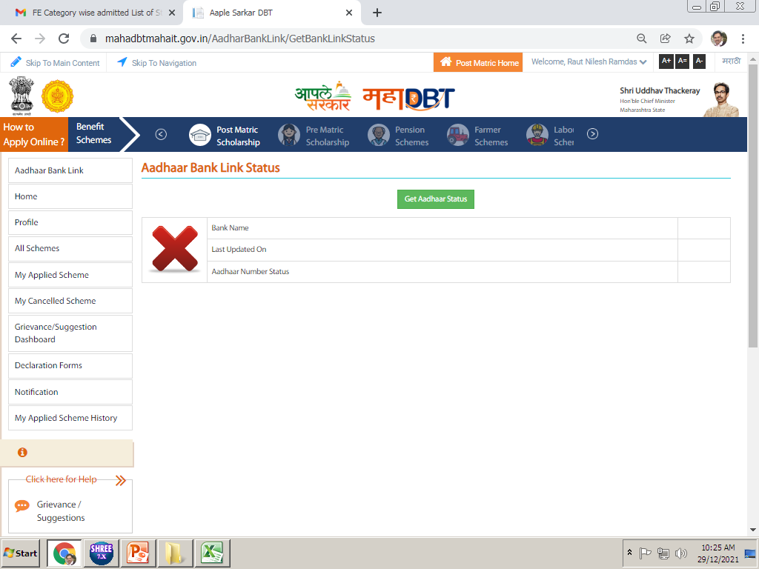
Click on Get aadhar status
Notes:
Click on Get Aadhar Status to show the current status of Aadhar Bank linking.

Slide 16
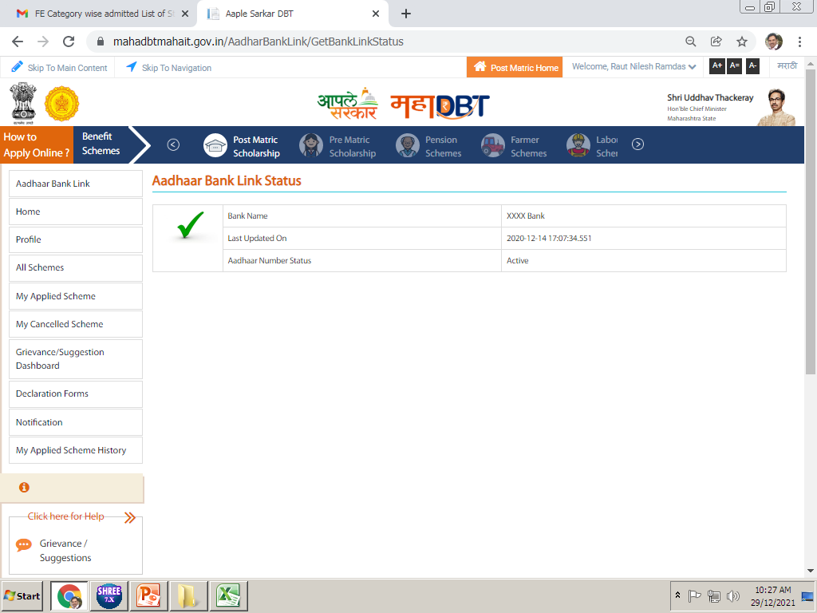
* Aadhar Number Status should be Active.
If your aadhar Number status is deactive or if it is not showing here then you need to link your aadhar number with your bank account. Visit to your Bank with aadhar linking form.

Slide 17
Click on the Profile option…

Slide 18
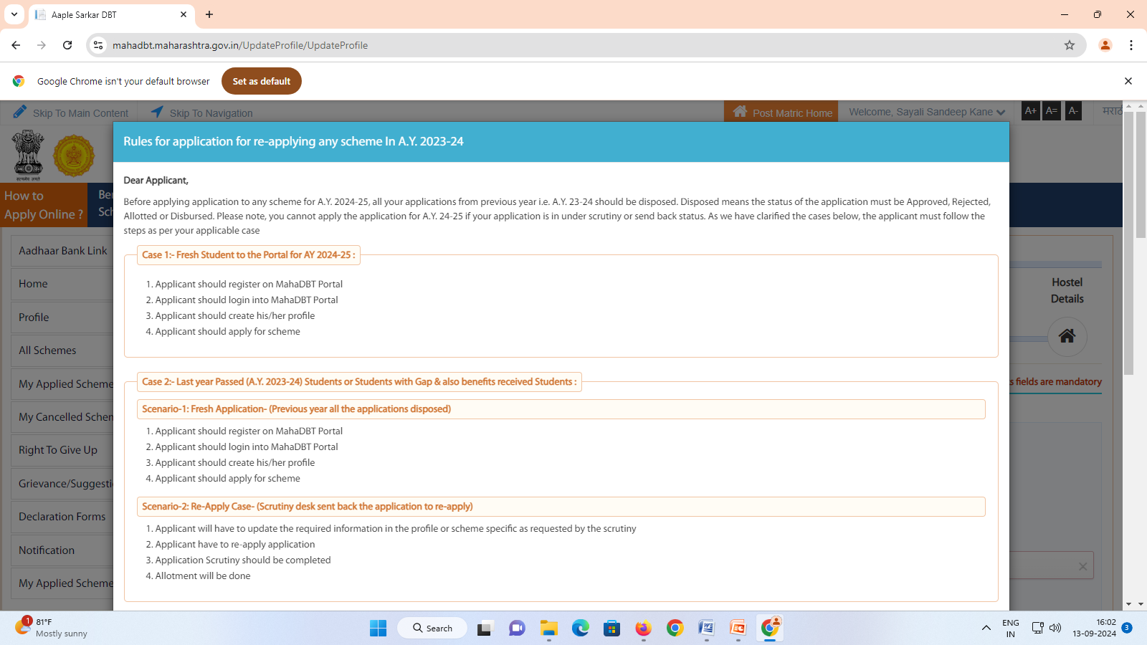
READ ALL INSTRUCTIONS CAREFULLY

Slide 19
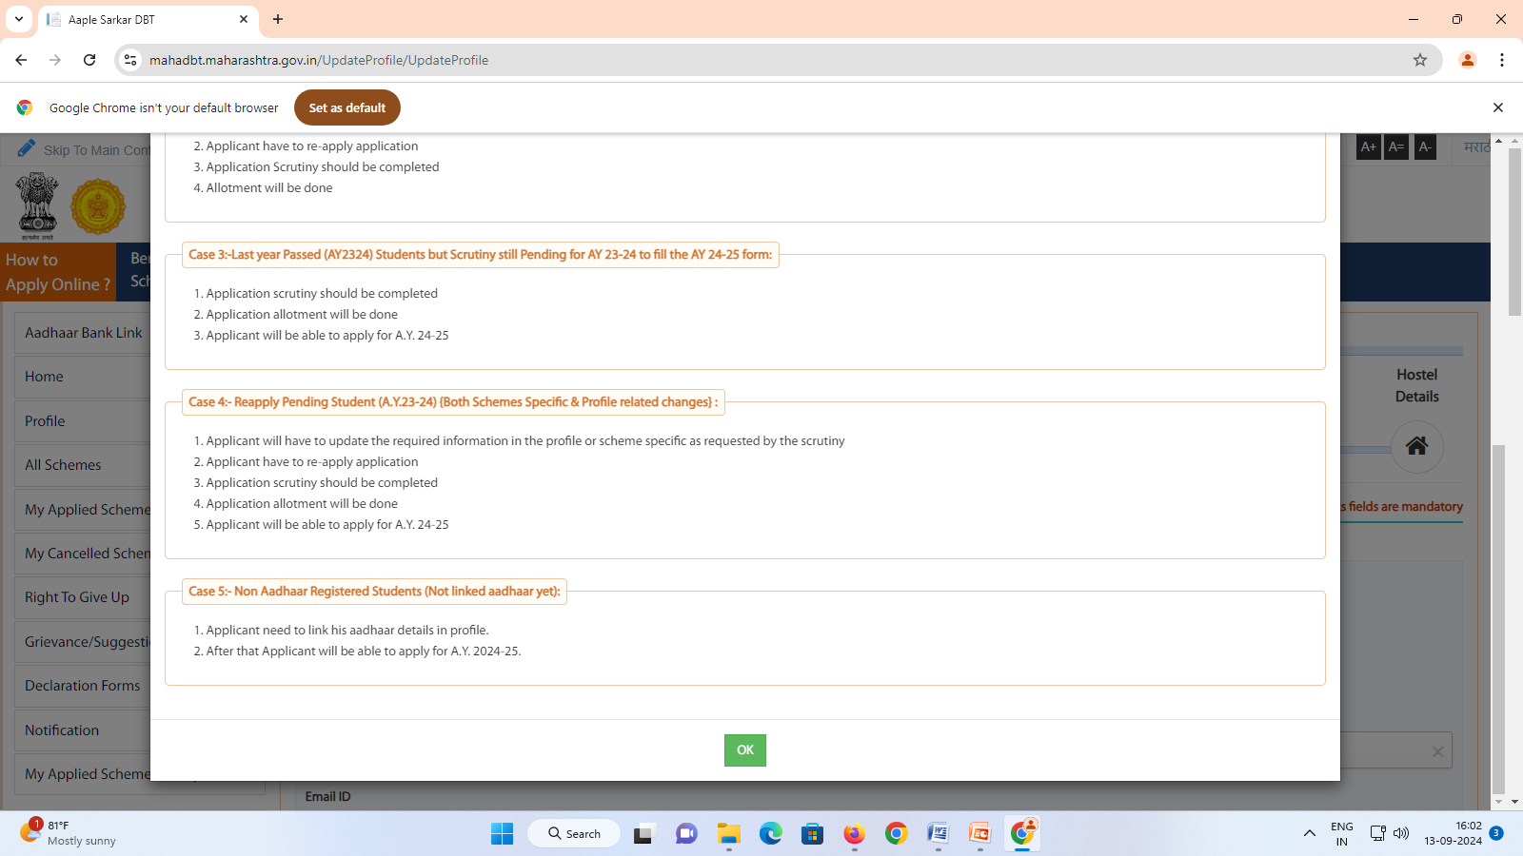
CLICK ON OK

Slide 20
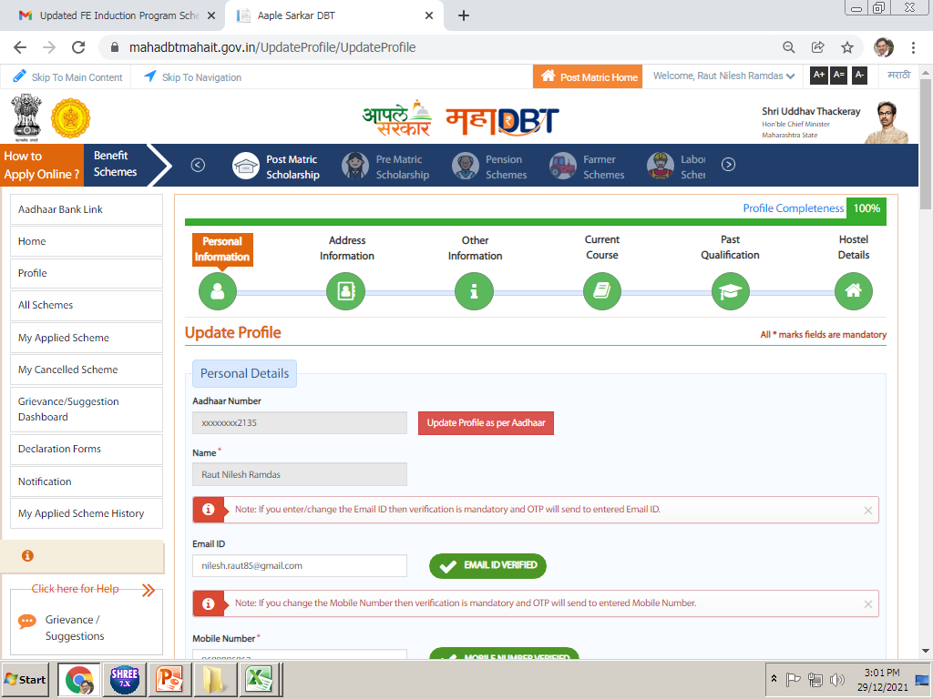
Click on this for linking this form with adhar
Notes:
Here we have to create our students profile in this option. Profile is distributed in six parts. We have to update all these six parts of Profile.

Slide 21
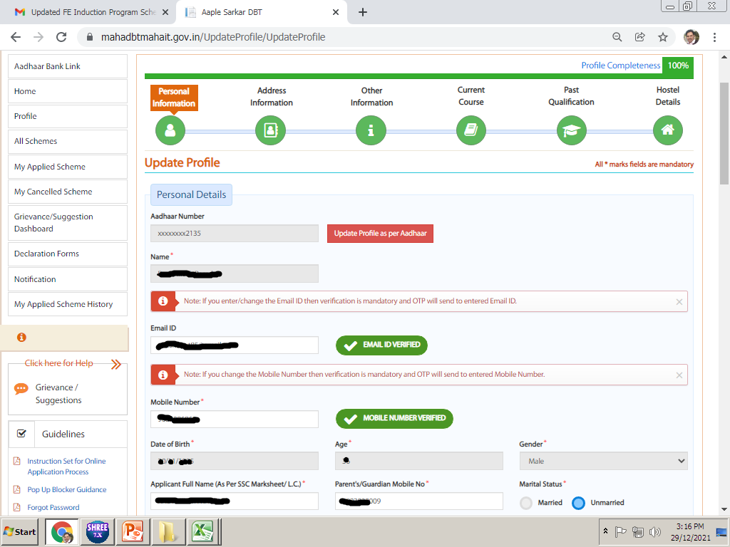
click on Update profile as per aadhar.
Then all the details will come as per aadhar…
Enter your email id
Enter your Mobile

Slide 22
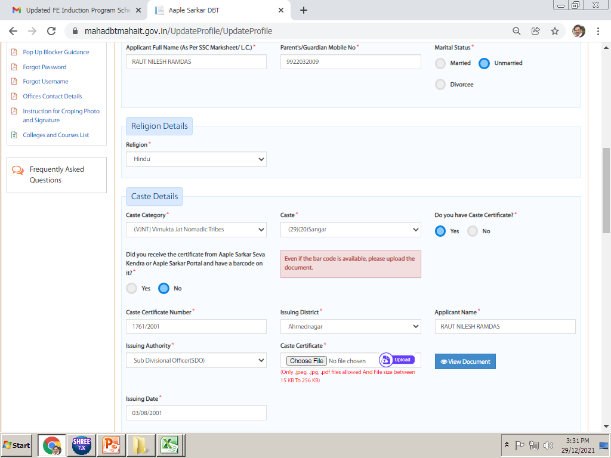
Select your religion.
Select your Caste Category
In this part enter your caste certificate details and upload your caste certificate (in PDF/JPG format only).
Notes:
For SC Category students, upload your caste certificate and caste Validity certificate in a single pdf file.
Open category students need not to upload caste certificate or caste details.

Slide 23
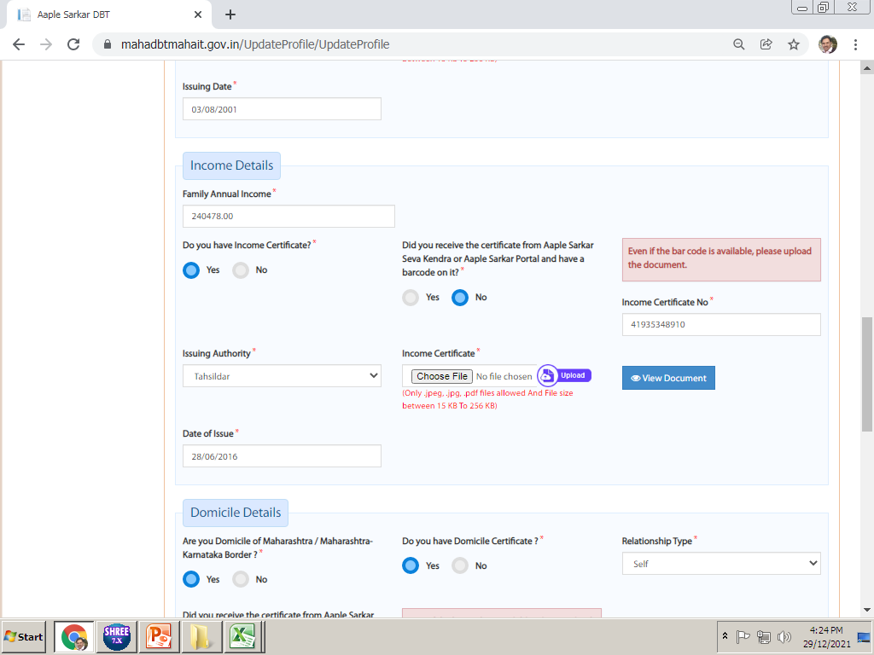
Income details :- In these details, student need to update their Income certificate details. Students belong to SEBC/SBC/VJNT/OBC whoes income above 2.5 lakh then they must attach non crème with income certificate in one file
Note :- Against Cap institute level admission those income for SC/ OBC/SBC/VJNT category below Rs.250000/- can apply for scholarship
Enter your Parents Annual income here
Upload Income certificate of your father of FY 2024-25. In case Income certificate of Mother, Upload supporting documents with Income certificate like death certificate of father or if separation upload affidavit. if any… (Scan both documents in single file and upload)

Slide 24
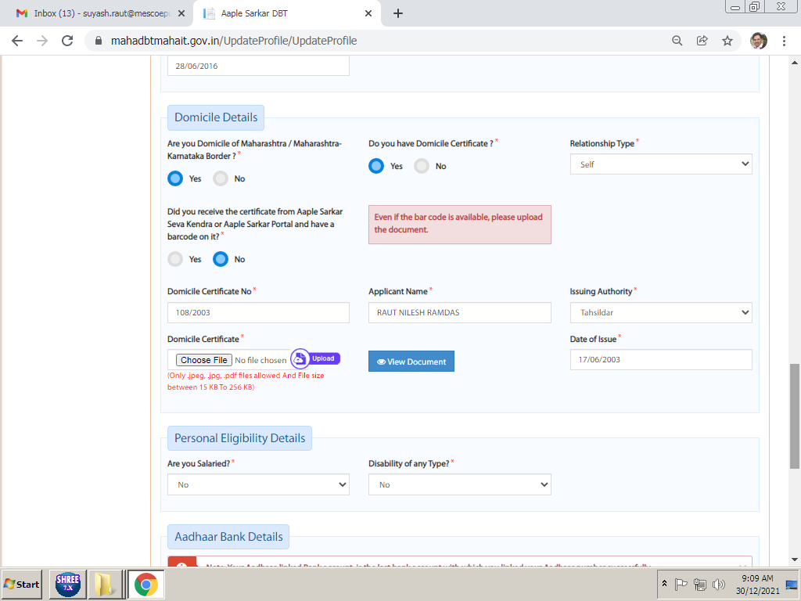
Domicile Certificate details. Domicile certificate is mandatory for all schemes.
In this students needs to update his/her Domicile Certificate details.
Upload domicile certificate in pdf /jpg format here. Rahivasi praman patra chalnar nahi

Slide 25
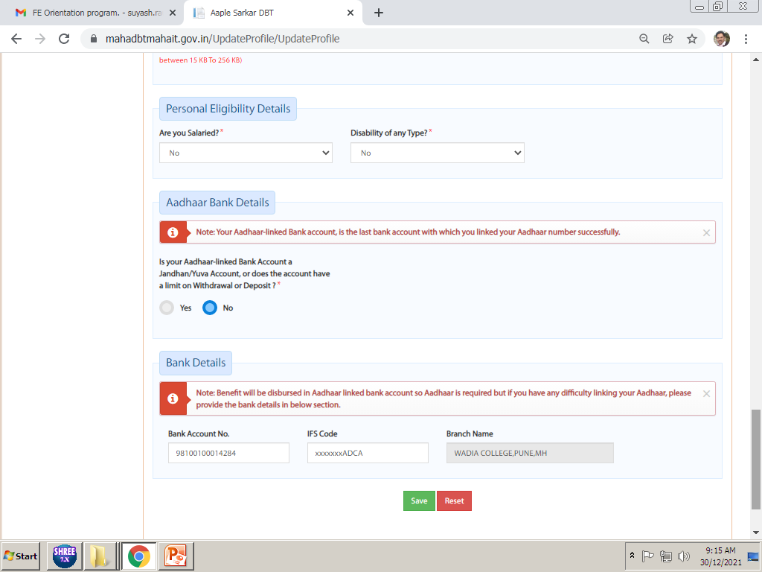
Enter personal eligibility details, and Bank details of students adhar must link with bank here…
All SC/OBC/VJNT/SBC SCHOLARSHIP (INCOME BELOW 2.5 LAKH) STUDENTS HEREBY INFORMED THAT IN THIS BANK SCHOLARSHIP 60% AMOUNT RECEIVED SO STUDENTS ADVISED THAT BANK MUST ACTIVE MEAN YOU HAVE TO KEEP TRANSCTION ATLIST IN 15 DAYS.
Click on the Save option after update all these details, this will Save all personal details in Profile.

Slide 26
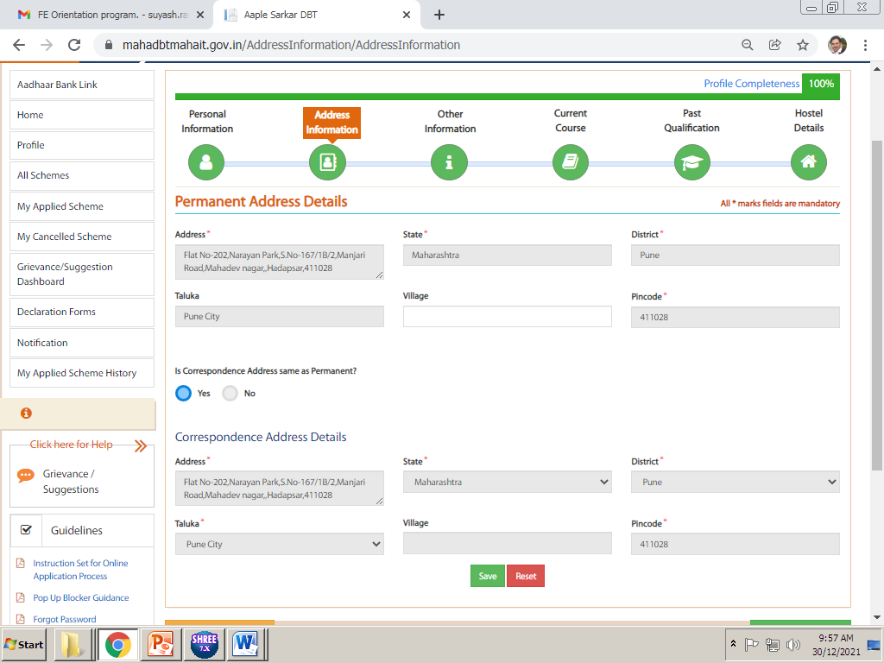
In this details students needs to update their Permanent Address and Correspondence Address details and Click on Save.
Click on save

Slide 27
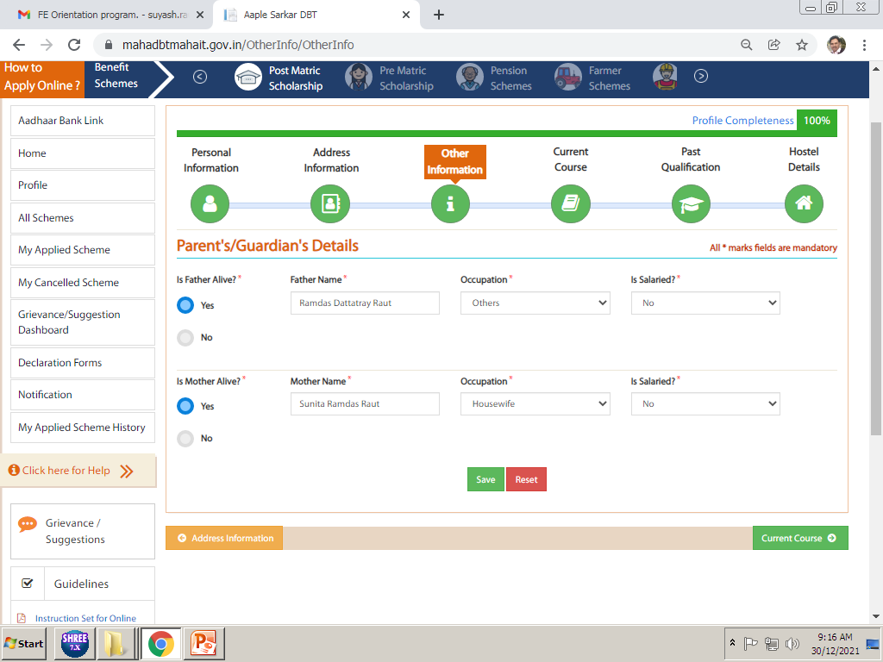
CLICK ON SAVE
In Other Information You have to select Parents Details. Occupation of Parents. Click on Save after update

Slide 28
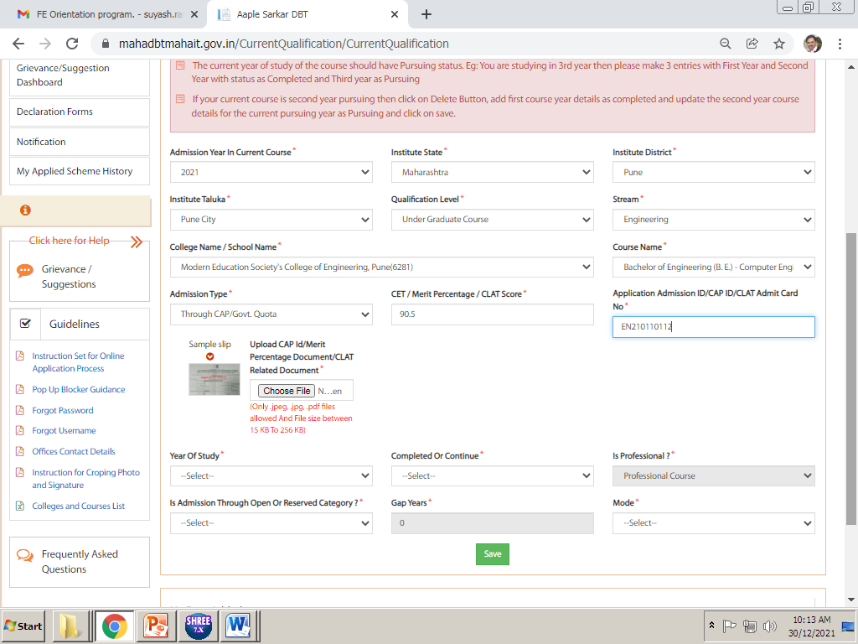
PUNE CITY
DIPLOMA COURSE
ENGINEERING
Cusrow Wadia Institute of Technology (aided)pune
Post s.s.c.diploma in enng(polytechnic)
10TH/12TH MARKS
DEN/DSD NO :
2021
Upload Admission Confirmation Letter i.e. Allotment Letter in this CAP ID. Do not Upload freeze and confirm letter or any other document in this. Please see next slide for admission confirmation letter.
Pune City
Modern Education Society’s College of Engineering(6281)
Notes:
Very Very Important Part of your form. These details must be 100% Accurate as per given in above picture

Slide 29
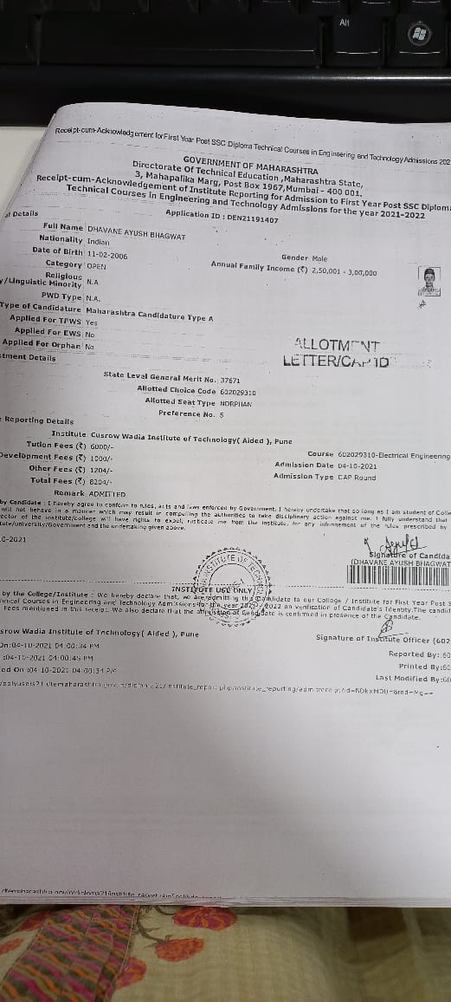
Specimen of allotment letter

Slide 30
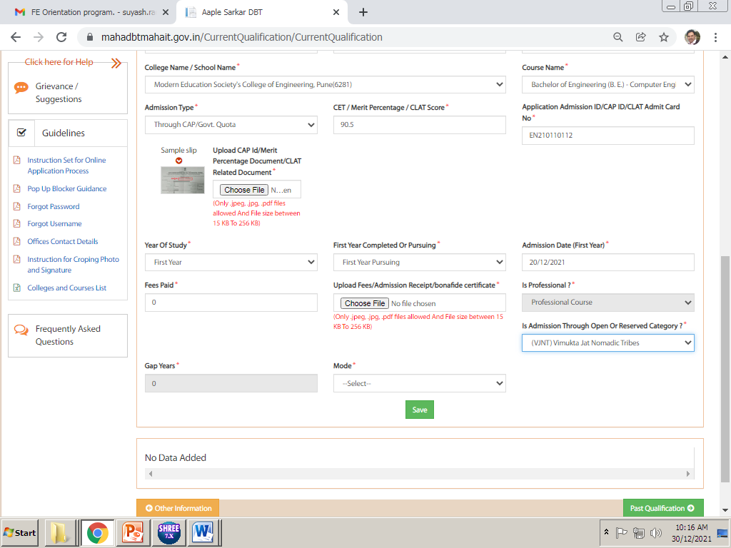
This is very important point of the Fees. You need to enter fees paid amount as “ 0 ” only.
Only Students who have paid Admission Fees Rs. 8204/-7994/- or 80695/-,80475/- Can enter these amount in Fees Paid for refund of admission fees. Do not enter any amount in fees paid if you have paid Admission Fee in concession . i.e. Rs.2204/1984/5204/11089/ 45872/10869/45652 (ONLY ST CATEGORY STUDENTS CAN FILLUP Rs. 2204/1984/10729/10869 paid) TFWS STUDENTS NOT ELIGIBLE FOR ANY SCHOLARSHIP
Upload original Admission fees receipt at this point. Do not upload bonafide certificate select other details and click on Save.

Slide 31
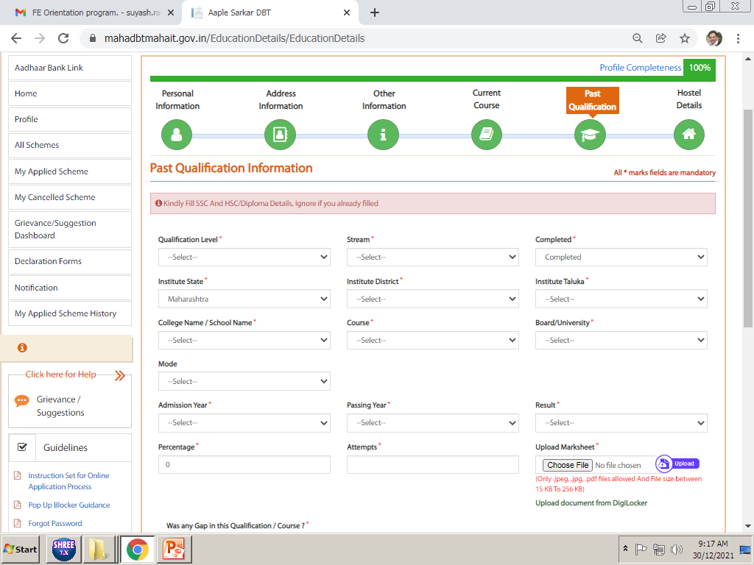
In this details students need to add his/her SSC/HSC/ITI Qualification Details, Upload all mark sheets in original copies. Upload gap certifcate if any along with mark sheets

Slide 32
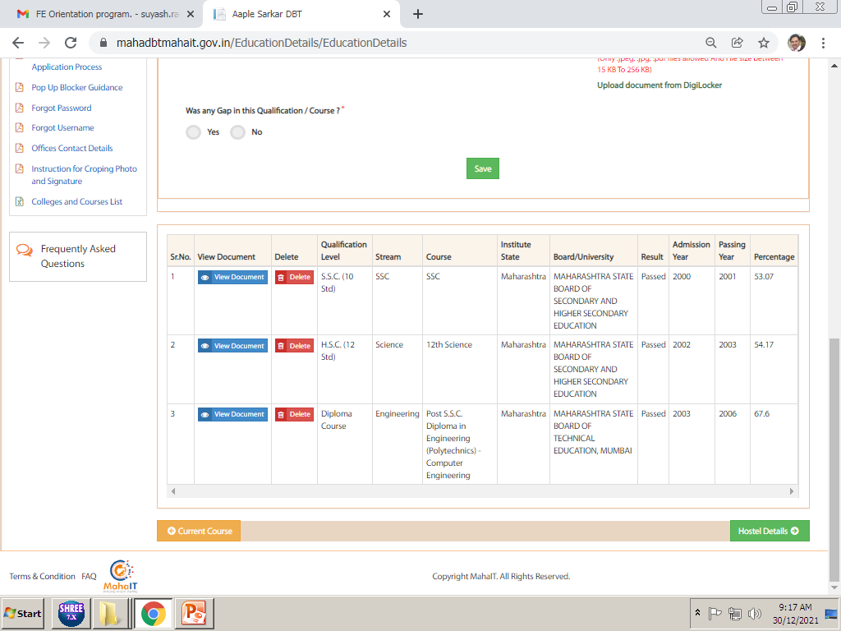
Past Qualification details after update all previous qualification details

Slide 33
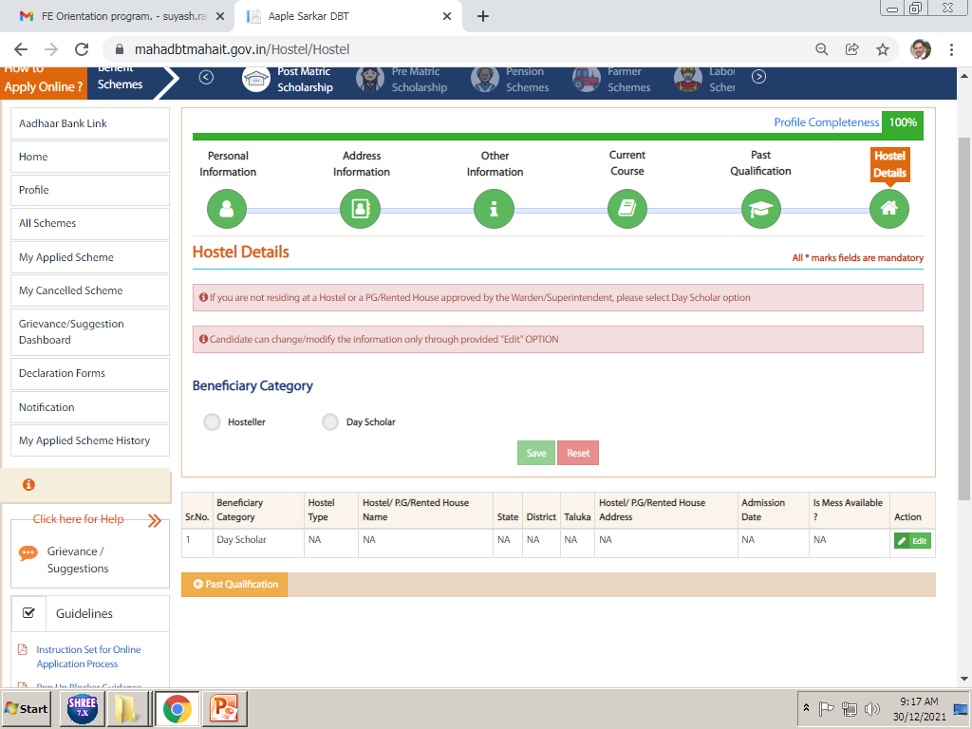
After update hostel details students profile is completed 100%, now he/she needs to apply for scheme as per his/her eligibility.
If Students Staying in Hostel then he/she need to update Hostel Information here, upload hostel receipt/rent agreement here.
For Hostel Scheme benefits, it is mandatory to update these details (FOR VJNT/SBC VJNT HOSTEL SCHEME IS AVAILABLE students those income below Rs. 250000/- they can select this scheme option (only wadia college hostel allowed. For open panjabrao deshmukh hostel scheme available )
(For SC category swadhar scheme hmas.mahait.org is available for those who didn’t leave in government hostel, having above 60% and income below 2.50 lakh. For ST category swayam hostel scheme is available.)

Slide 34
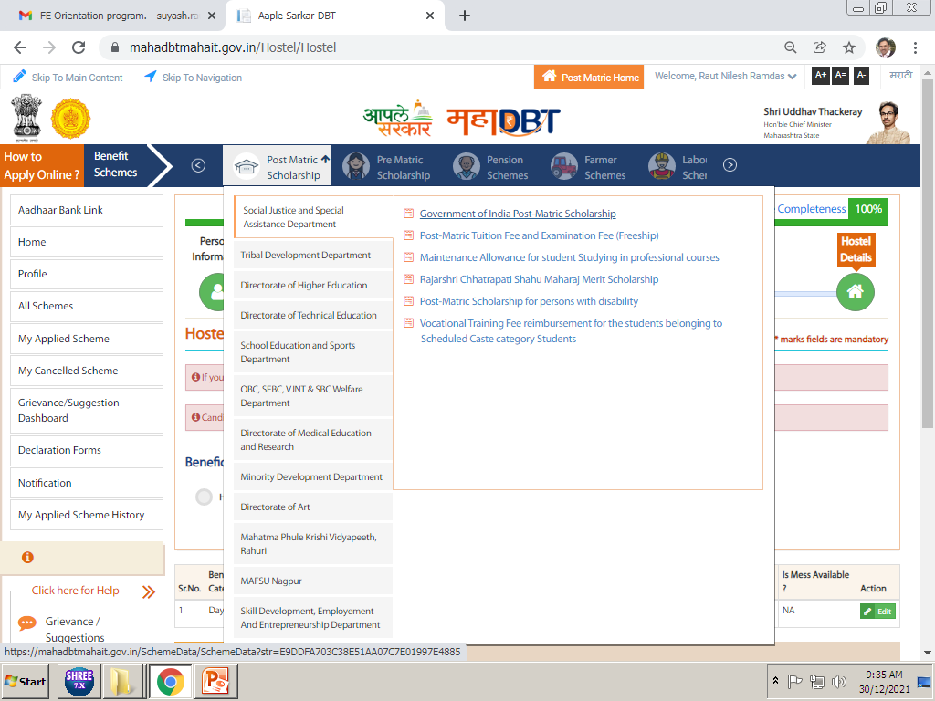
In all scheme tab, select your Department name and click on scheme name as per your eligibility. For detail see notice which is given in students grp

Slide 35
Category wise and Income wise applicable schemes to be select.
Category | Parents Income | Department Name | Scheme Name
OPEN, SEBC,EWS | Below 8 Lakh | Directorate of Technical Education | Rajashri Chatrapati Shahu Maharaj Fee Reimbursement Scheme
SC | Below 2.50 Lakh | Social Justice and Special Assistance dept. | Govt of India Post-Matric Scholarship
 | 250001 onwards | Social Justice and Special Assistance dept. | Post Metric Tuition fee and Examination Fee (Freeship)
OBC, VJNT & SBC | Below 2.50 Lakh | OBC, SEBC, VJNT, and SBC welfare Department | Post Metric Scholarship to OBC/SBC/VJNT Students
 | 250001 onwards | OBC, SEBC, VJNT, and SBC welfare Department | Tuition Fees and Examination Fees to OBC/SBC/VJNT Students
ST | Below 2.50 Lakh | Tribal Development Dept. | Govt. of India Post-Matric Scholarship.
 | 250001 onwards | Tribal Development Dept. | Vocational Education Fee Reimbursement Scheme(Freeship)

Slide 36
Category wise and Income wise applicable hostel schemes to be select.
Category | Parents Income | Department Name | Scheme Name
OPEN, SEBC,EWS | Below 8 Lakh | Directorate of Technical Education | Panjabrao deshmukh scholarship
SC | Below 2.50 Lakh marks above 60% | Swadhar scheme
VJNT & SBC | Below 2.50 Lakh | VJNT, and SBC welfare Department (only wadia college hostel students can apply for this scheme) | Payment of Maintenance Allowance to VJNT and SBC Students Studying in Professional Courses and Living in Hostel Attached to Professional Colleges
ST | Below 2.50 Lakh marks above 60% | Swayam scheme

Slide 37
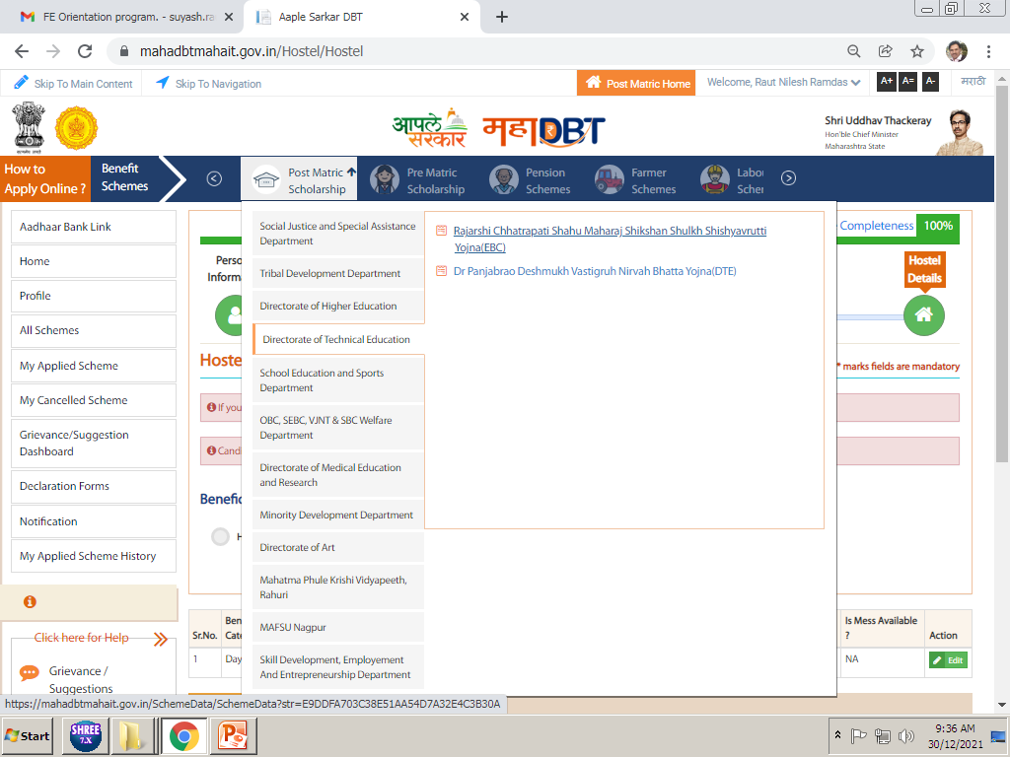
CLICK ON ALL SCHEME FOR APPLY ON MAHADBT PORTAL AFTER COMPLITION OF 100% PROFILE

Slide 38
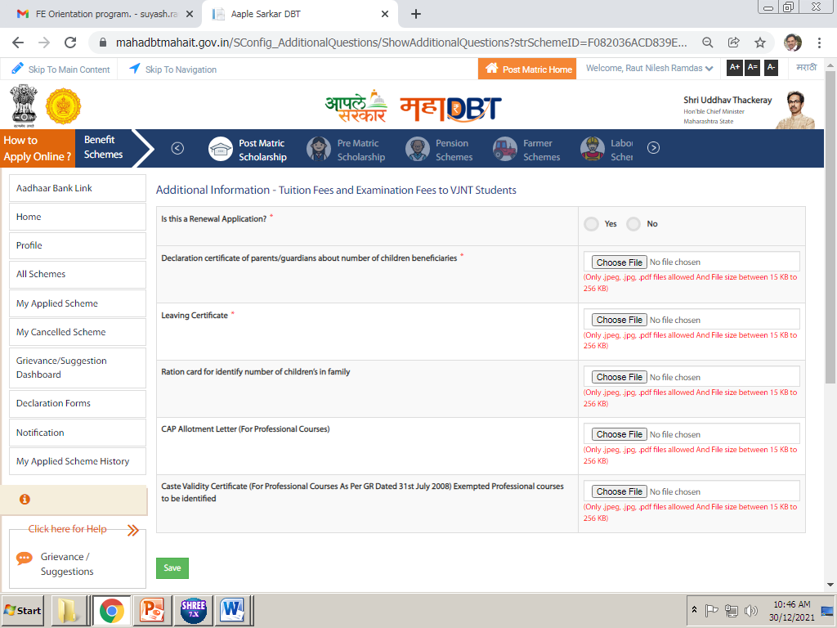
Is this renewal application, FY/DSY students Select NO,
Mandatory to upload (undertaking)
Leaving & Ration card Mandatory to upload
upload allotment letter/cap id
Mandatory to upload only for ST freeship
After applying scheme, fill up above details. Upload all the required documents in above and click on save.
Imp Note. All documents Mentioned here are important and needs to be uploaded, failing to upload will result in rejection of your application.

Slide 39
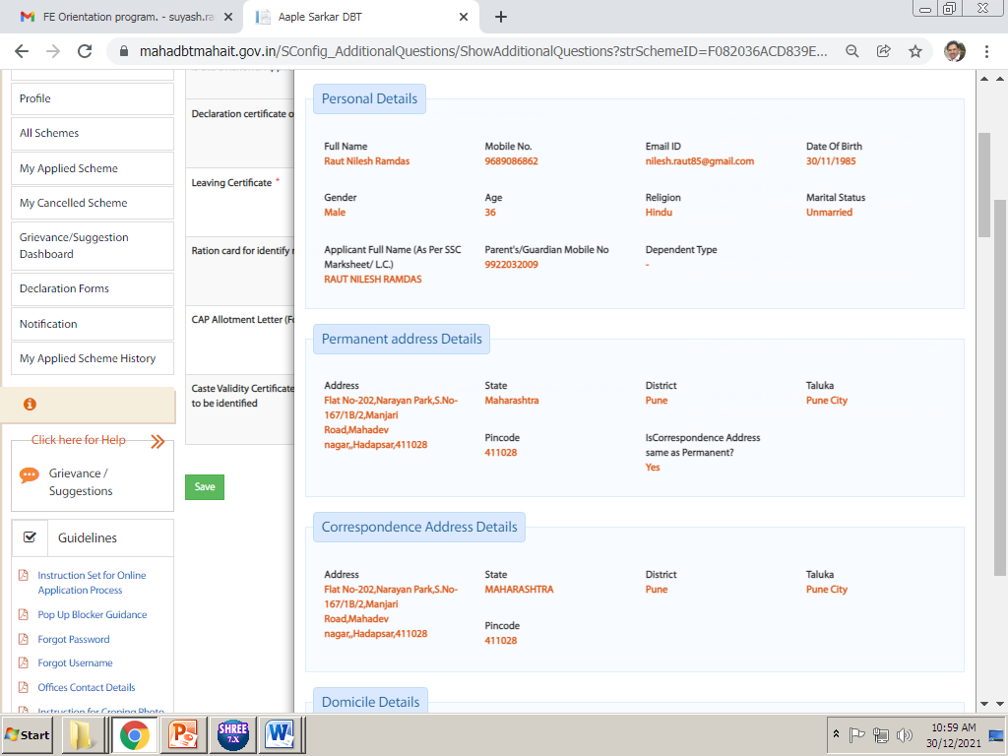
After click on the Save next page will come like this, verify all the details filled by you in this page, and scroll down to end for submission of application.

Slide 40
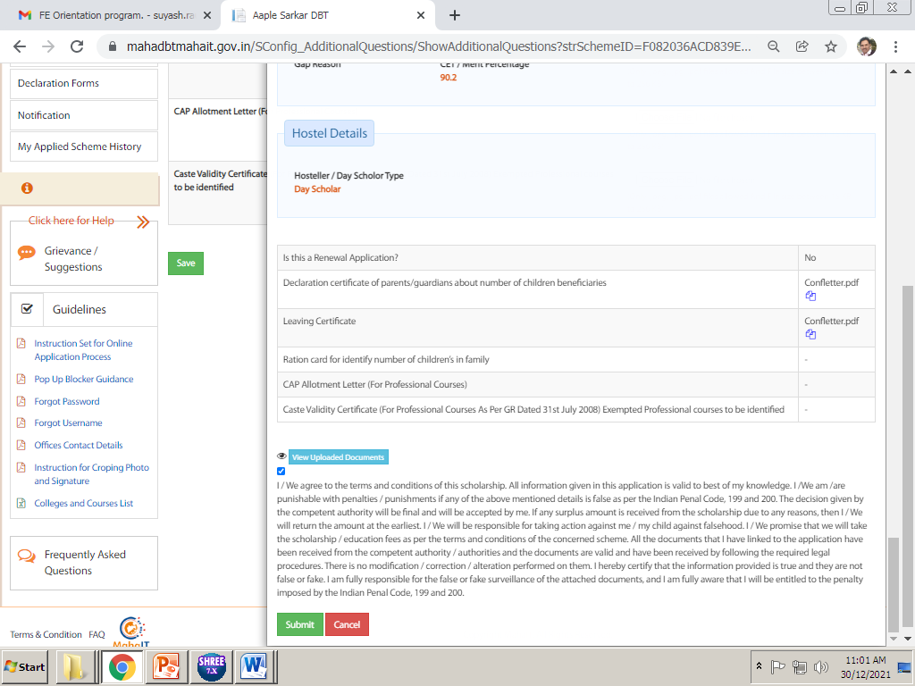
ENSURE YOUR UPLOADED DOCUEMNTS
Tick on that check box to submit the application and click on Submit Button to submit application.
ENSURE YOUR UPLOADED DOCUEMNTS
IMP NOTE :- PLEASE ENSURE YOUR UPLOADED DOCUEMNTS ONCE AGAIN THEN ONLY SUBMITE ONLINE After successful submission of online application you need to take printout or pdf copy of your application for submission to college with required documents.

Slide 41
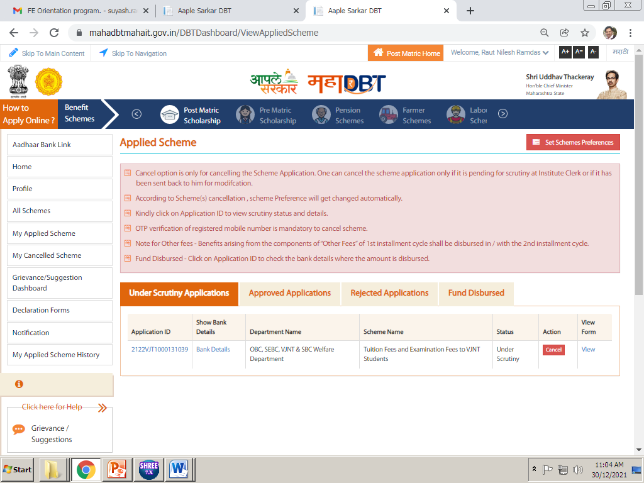
Click on My applied scheme
Click on view to take print out of form
For this go to My applied scheme and there you will find your application in Under Scrutiny tab, click on View in last colomn.

Slide 42
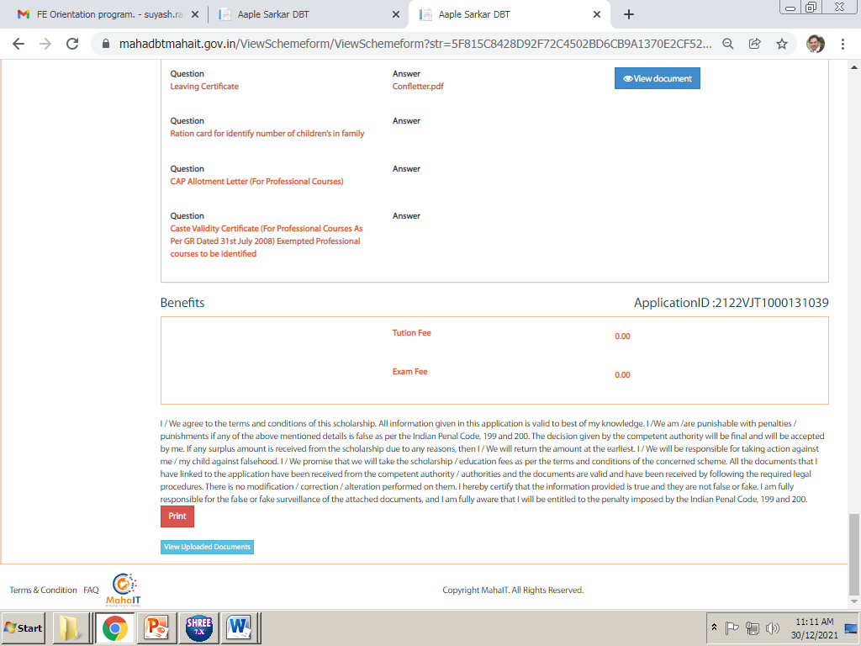
Click on print option to take printout or pdf copy of the form…

Slide 43
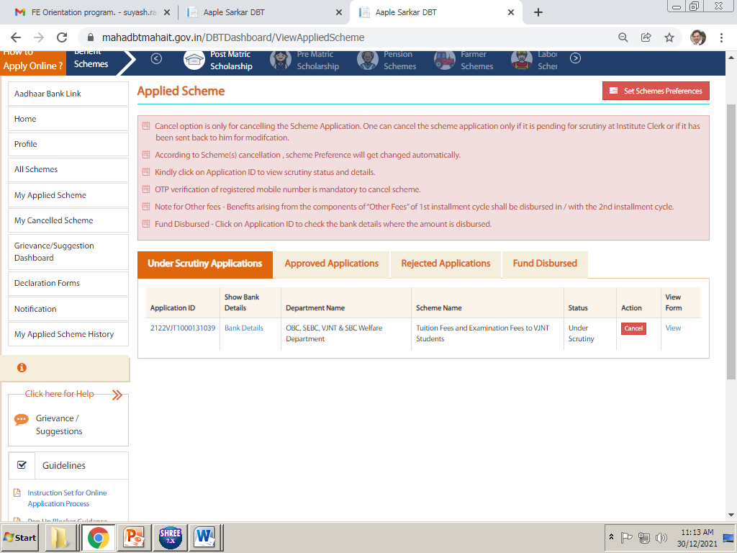
IF YOUR FORM SEND BACK THEN YOU HAVE TO SEE IN MY APPLIED SCHEME
Click on my applied scheme for these details
If send back reapply button appear here
In My applied scheme, you will find all update i.e. send back or approved IF YOUR FORM IS SEND BANK CLICK ON APPLICATION ID HERE YOU CAN SEE MESSAGE FROM GOVERNMENT OR COLLEGE WHY YOUR FORM IS SEND BACK.

Slide 44
PUNE CITY
DIPLOMA COURSE
ENGINEERING
Cusrow Wadia Institute of Technology (aided)pune
Post s.s.c.diploma in enng(polytechnic)
10TH/12TH MARKS
DEN/DSD NO :
IF SEND BACK DUE TO ALLOTMENT LETTER OR FEE PAID ZERO THEN YOU HAVE TO DELETE PREVIOUS FILLED CONTENT THEN FILLED ALL DETAILS AGAIN.
2021
Upload Admission Confirmation Letter i.e. Allotment Letter in this CAP ID. Do not Upload freeze and confirm letter or any other document in this. Please see next slide for admission confirmation letter.
Pune City
Modern Education Society’s College of Engineering(6281)
Notes:
Very Very Important Part of your form. These details must be 100% Accurate as per given in above picture

Slide 45
CLICK THIS MENU FOR REAPLY OR SEND BACK
HERE GREEN BUTTON AVAILABLE HERE YOU HAVE TO CLICK FOR REAPLY

Slide 46
FOR REAPLY/SEND BACK YOU HAVE TO UPLOAD ONCE AGAIN ALL THESE DETAILS
Is this renewal application, FY/DSY students Select NO,
Mandatory to upload (undertaking)
Mandatory to upload Leaving & ration card
upload allotment letter/cap id
Mandatory to upload only for ST freeship
After applying scheme, fill up above details. Upload all the required documents in above and click on save.
Imp Note. All documents Mentioned here are important and needs to be uploaded, failing to upload will result in rejection of your application.

